Slide 1
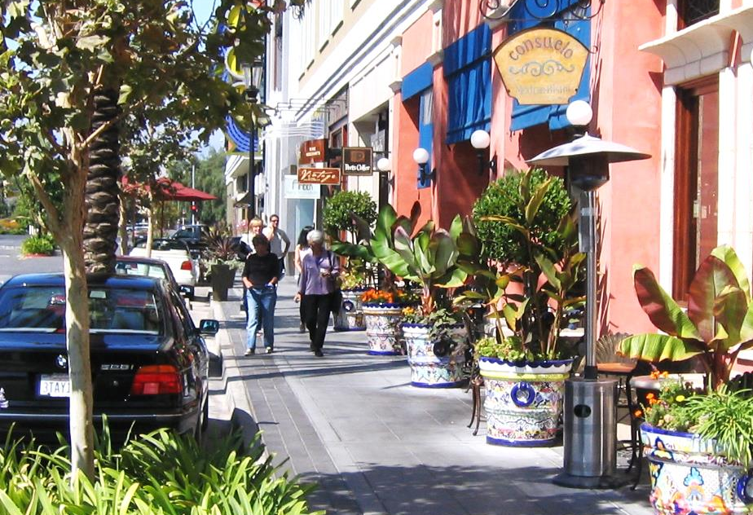
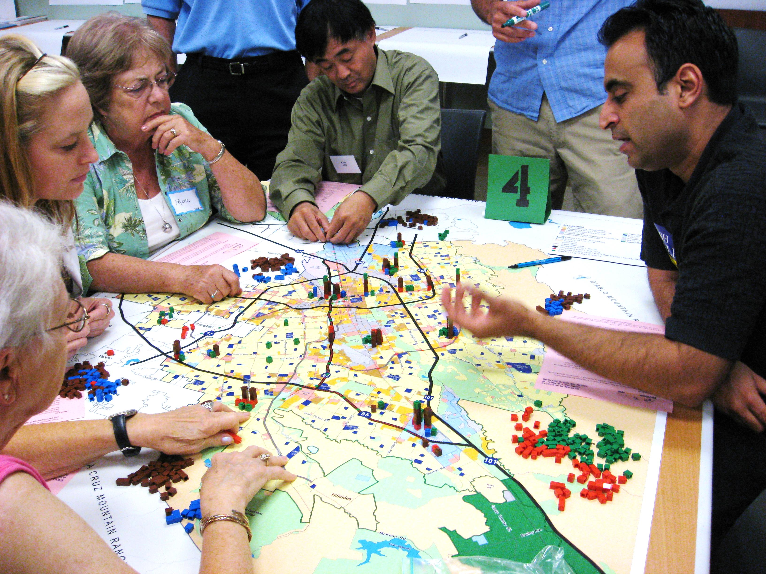
Planning Commission 101:
The Nuts and Bolts of Planning
Presented by
Marc Roberts, Retired Livermore City Manager
Cal Cities 2023: Planning Commissioners Academy | March 29, 2023
Notes:
I love specific plans!
Going to walk through adoption of a specific plan and revitalization strategy; see the impacts of the plan
Then applying that plan to a specific project and see what happens
So, let’s start with how we adopted one of our specific plans in Livermore.

Slide 2
Inception of Downtown Revitalization
Visioning 2001 - 2002
  The City conducted a City-wide visioning effort
  Downtown was in decline and was a focus of concern
  Visioning call for a revitalization plan and led to a Specific Plan process
2003 Specific Plan Workshops
  Community discussion on important issues for Downtown:
    Where to concentrate growth
    Density and height
    Transit
    Traffic impacts and pedestrian orientation
2017 Specific Plan Workshops
  Design of 8.2 Acre Catalyst Site
Cal Cities 2023: Planning Commissioners Academy Planning Commission 101

Slide 3
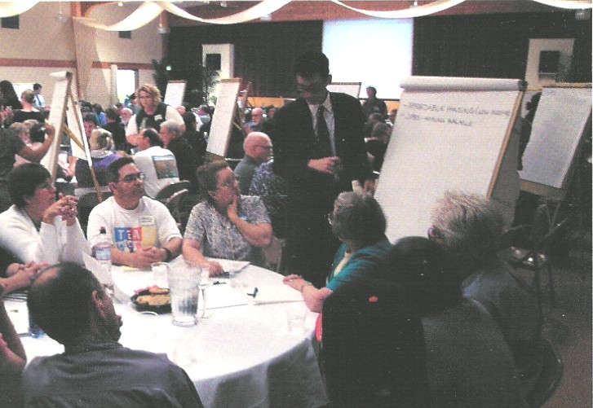
Community Workshops
Cal Cities 2023: Planning Commissioners Academy Planning Commission 101
Notes:
Five public workshops were conducted in 2002 and 2003

Slide 4
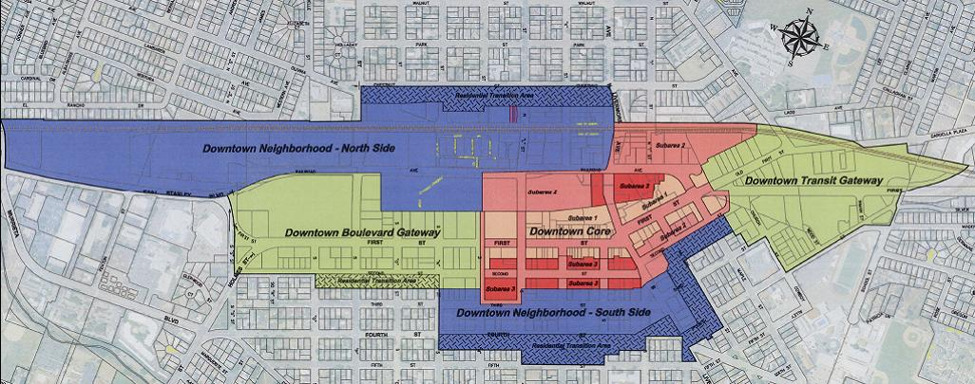
Specific Plan Area
Cal Cities 2023: Planning Commissioners Academy Planning Commission 101

Slide 5
Downtown Specific Plan Components
  Existing Conditions:
    Documents the land use pattern that existed in 2003/2004
  Revitalization Strategy:
    Provides a coordinated direction for all plan elements to achieve specific community objectives.
  Land Use and Development Policies
    Provides the regulatory framework governing development.
  Development Standards:
    Provides detailed regulations for site development.
  Design Standards and Guidelines:
    Provides specific direction on appropriate building types and principles of urban design to simplify the review process and provide greater certainty for developers.
Cal Cities 2023: Planning Commissioners Academy Planning Commission 101
Notes:
A Specific Plan is defined in State Law but NOT required.
Usually a neighborhood or segment of community rather that the entire community
Can include features of a General Plan, Zoning Ordinance, design guidelines, infrastructure standards and financing.

Slide 6

Downtown Specific Plan Components
Circulation and Transportation:
  Contains specific recommendations for First Street, new mid-block streets and alleys and other roadway improvements.
Parking:
  Identifies specific parking standards for new development and provides a parking strategy to meet the overall parking demand as the Downtown redevelops.
Public Utilities and Infrastructure :
  Identifies major capital improvements needed to support Downtown revitalization.
Implementation :
  Lists priorities for revitalization and identifies specific areas where focused investment will provide the most benefit in achieving community objectives. It also includes specific recommendations for Catalyst Projects that are designed to “jump-start” revitalization.
Cal Cities 2023: Planning Commissioners Academy Planning Commission 101
Notes:
Public Utilities and Infrastructure
In Livermore that included improvements to First Street as a catalyst to private development

Slide 7
Revitalization Strategy
Promote the concentration of activity-generating uses in a compact cluster in the center of Downtown.
Maximize investment in new housing construction throughout the Specific Plan Area.
Dramatically transform the character of the Downtown’s primary pedestrian space, First Street.
Focus immediate attention on opportunity sites capable of delivering dramatic short-term beneficial change.
Maximize transit opportunities.
Cal Cities 2023: Planning Commissioners Academy Planning Commission 101

Slide 8

Role of the Planning Commission
Approval/Amendment Process
  Review General Plan,
  Housing Element, and Zoning Code
  Conduct a public hearing
  Make a recommendation to the
  Board/City Council
  Board/City Council Adoption
  (Legislative Action)
Cal Cities 2023: Planning Commissioners Academy Planning Commission 101
Notes:
The Downtown Specific Plan was adopted in February 2004
What is the role of the Planning Commission during adoption?
To help make sure that the vision identified during the public workshop process is captured in the document and that the Commission understands how that Vision will be implemented.
This role is legislative and the Commission/Council has broad authority in this process.
How we will look at some before and after.

Slide 9
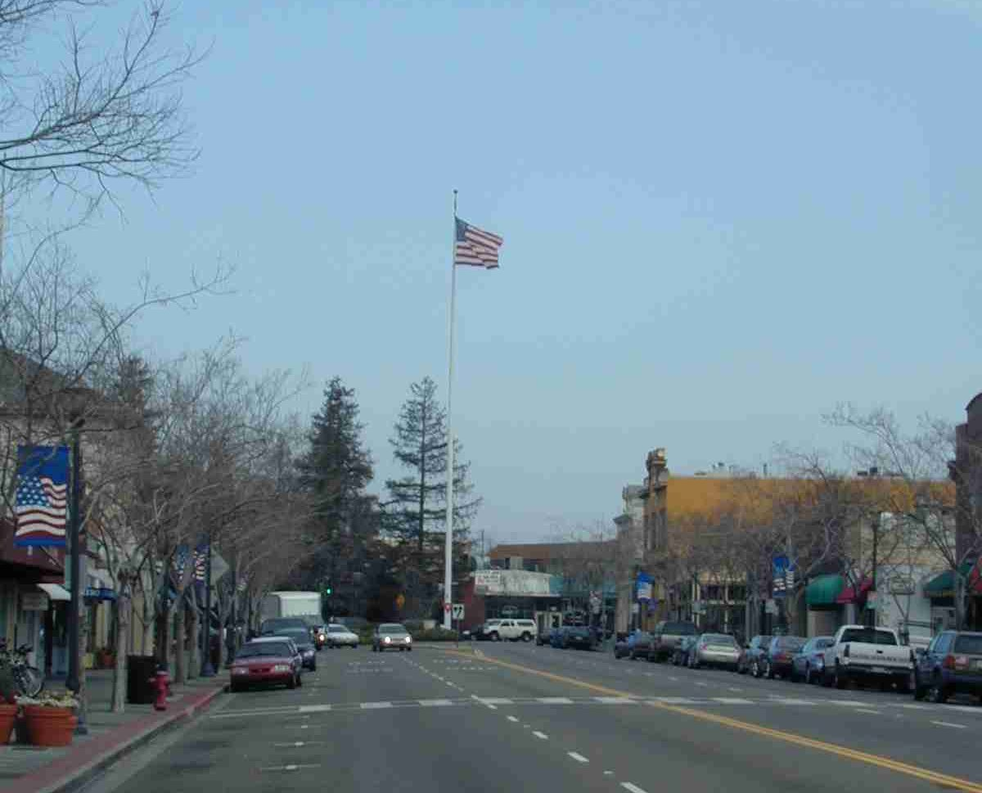
First Street Before
Cal Cities 2023: Planning Commissioners Academy Planning Commission 101
Notes:
The first project was to redevelop First Street (previously State Route 84)

Slide 10
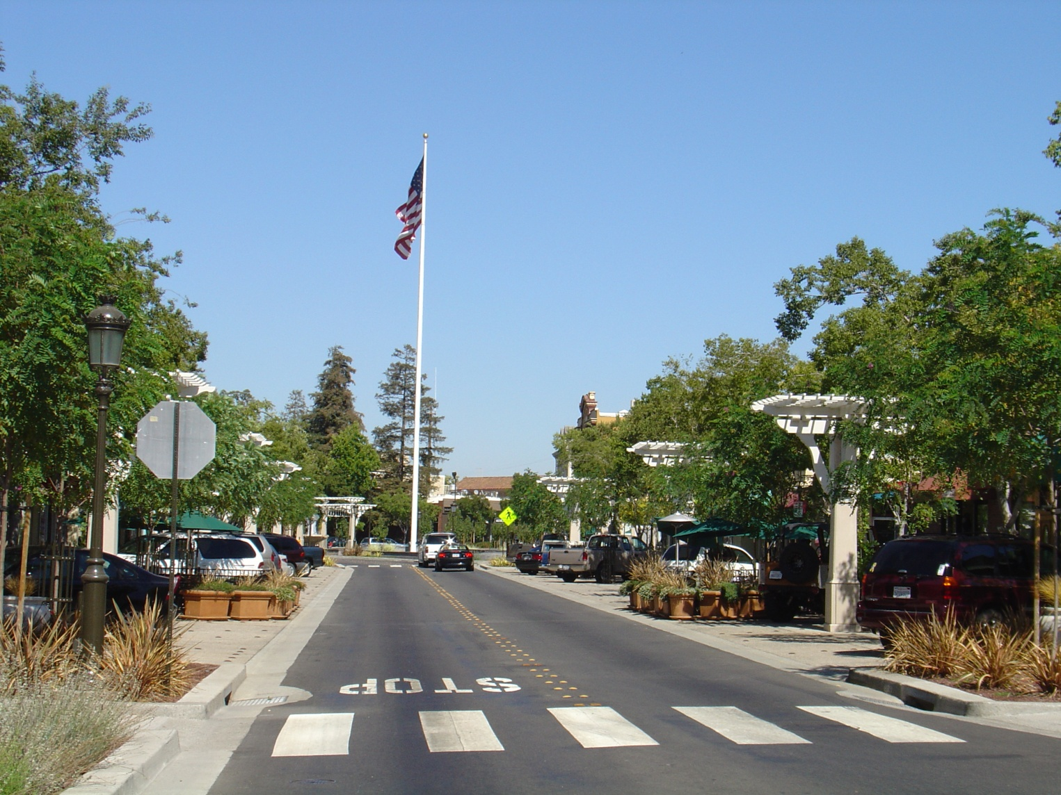
First Street After
Cal Cities 2023: Planning Commissioners Academy Planning Commission 101

Slide 11
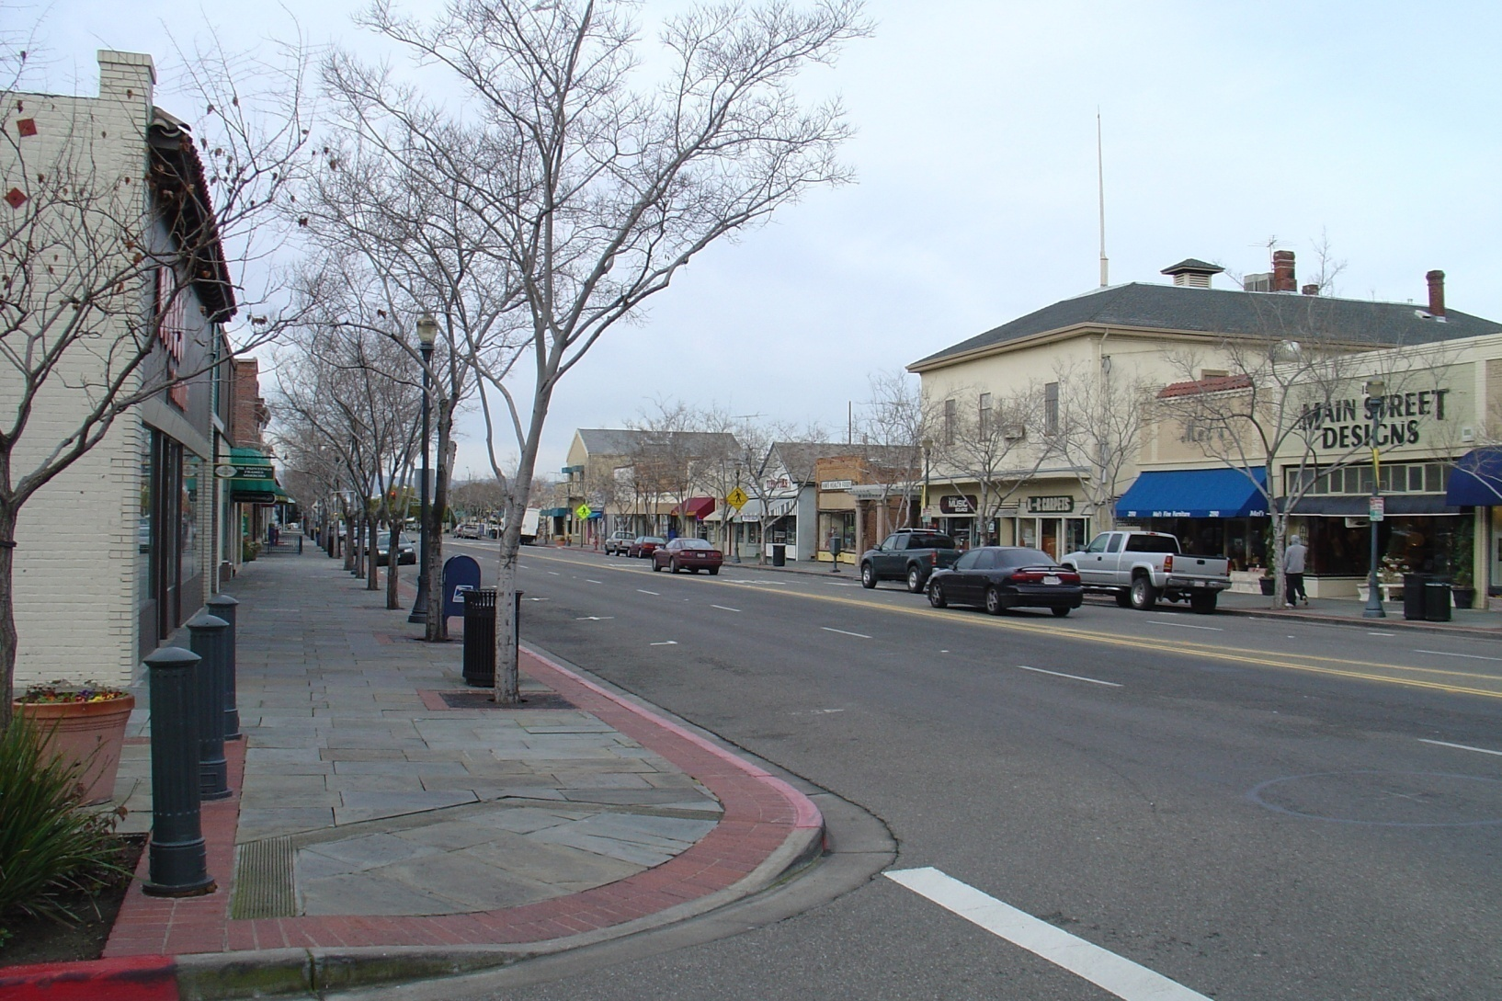
First Street Before
Cal Cities 2023: Planning Commissioners Academy Planning Commission 101

Slide 12
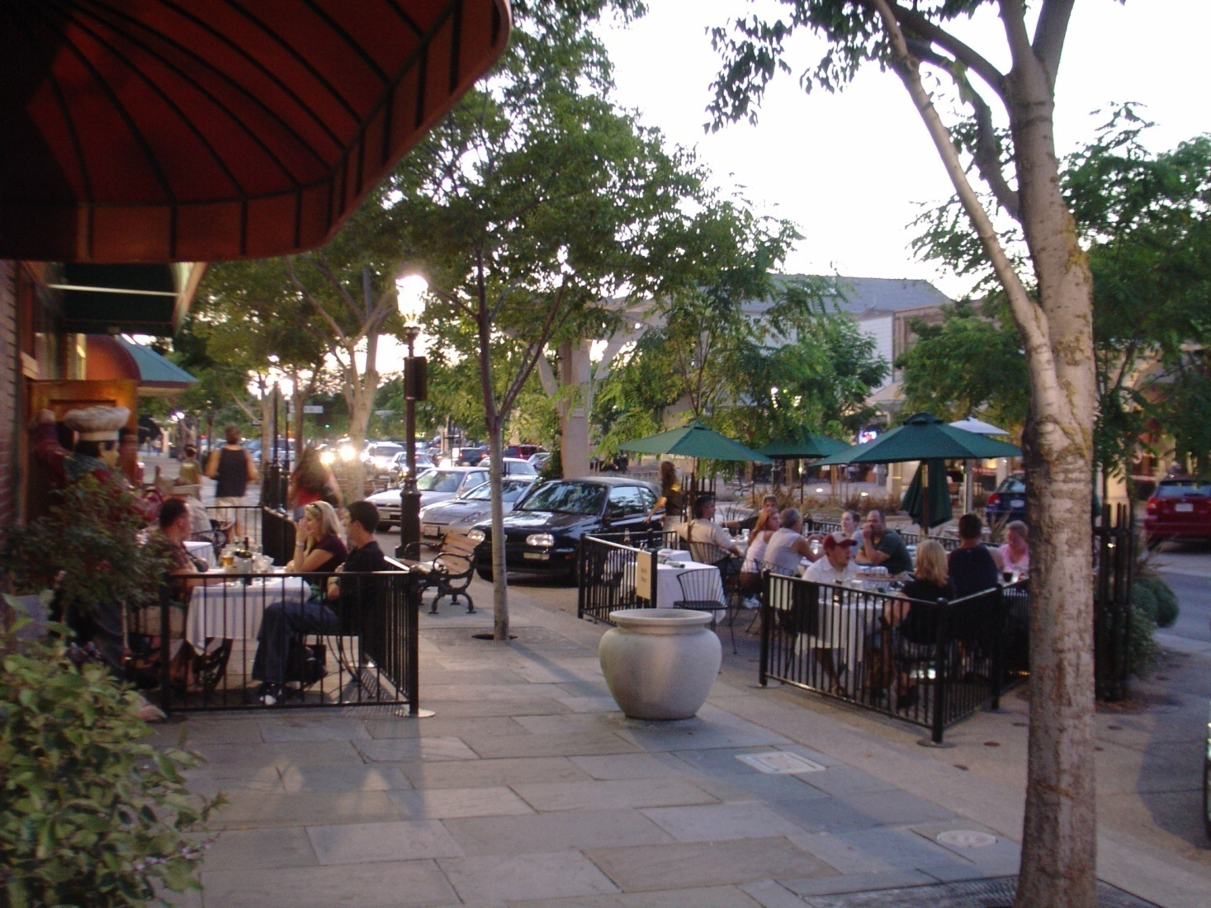
First Street After
Outdoor Dining: Flex Zone
Cal Cities 2023: Planning Commissioners Academy Planning Commission 101

Slide 13
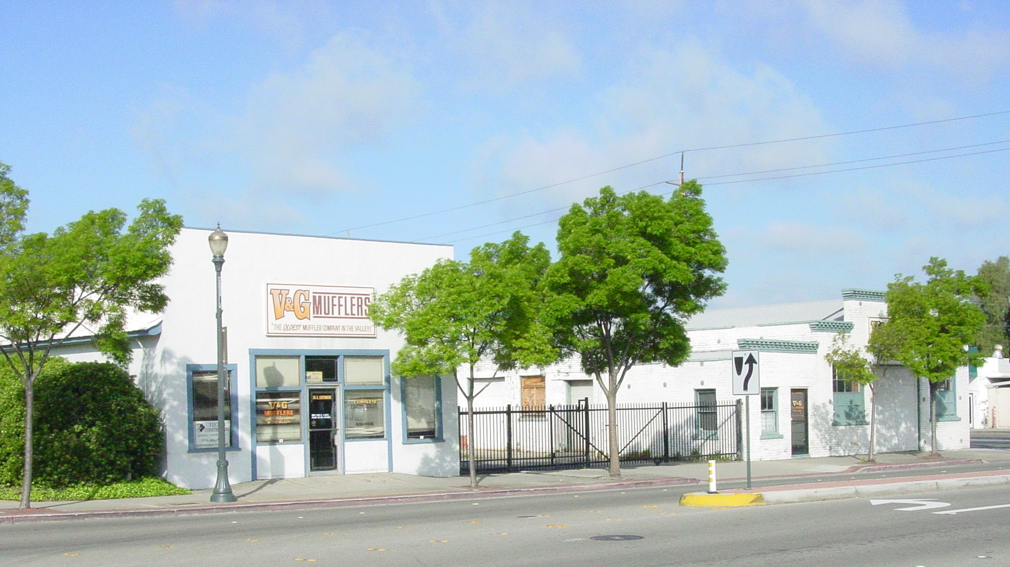
Blacksmith Square Before
Cal Cities 2023: Planning Commissioners Academy Planning Commission 101
Notes:
This led to private investment in Downtown

Slide 14
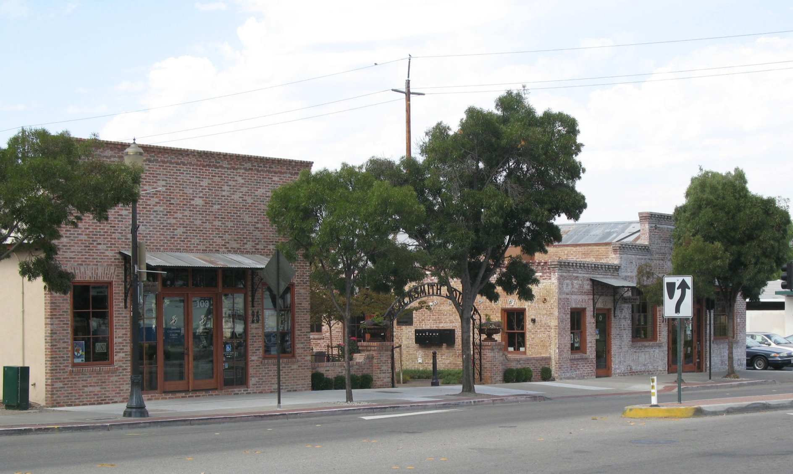
Blacksmith Square After
Cal Cities 2023: Planning Commissioners Academy Planning Commission 101

Slide 15
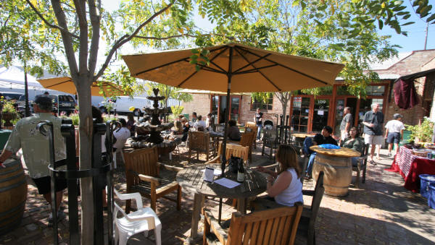
Blacksmith Square After
Cal Cities 2023: Planning Commissioners Academy Planning Commission 101

Slide 16
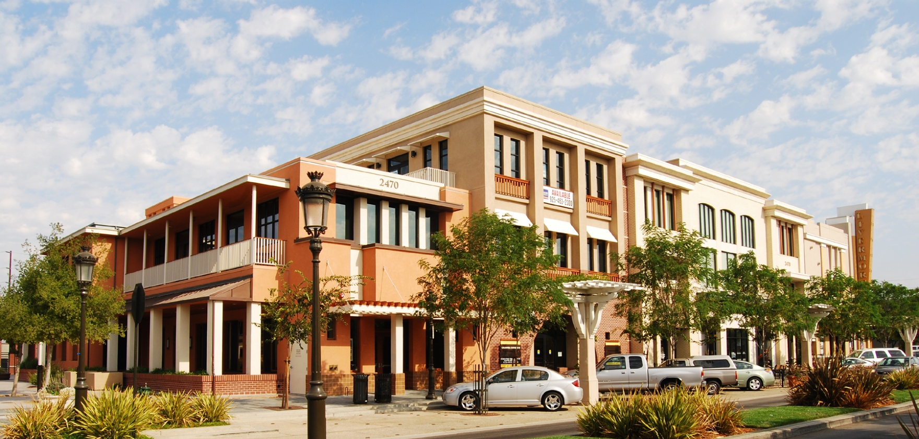
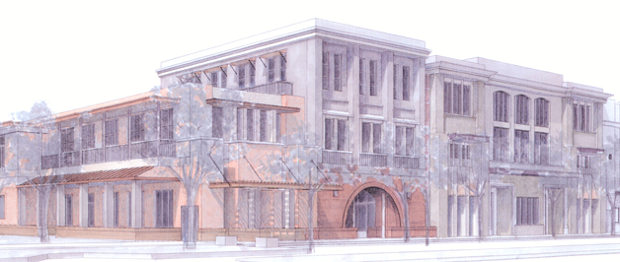
LVC Site: Mixed Use
Cal Cities 2023: Planning Commissioners Academy Planning Commission 101
Notes:
The adoption of the Specific Plan led to the implementation of several coordinated public sector an private sector projects.
So the slide shows a sketch of a development and the completed building.
How do you make sure the Community gets what is promised?
By having clear, enforceable Design Standards.

Slide 17
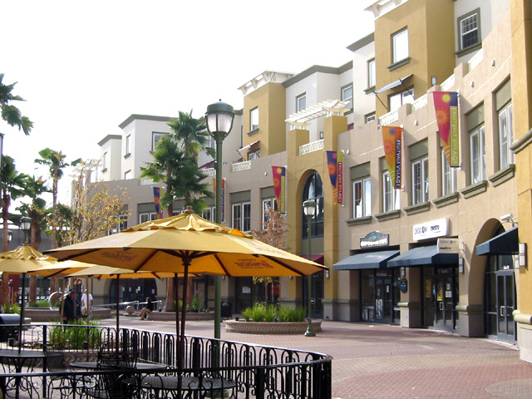
Role of the Planning Commission
Implementation Process
  Individual development project review
    Site and Architectural Permits
    Conditional Use Permits
    Other
  Consistency with the General Plan and
  Specific Plan
  Public hearing
Project approval (Quasi-Judicial Action)
Cal Cities 2023: Planning Commissioners Academy Planning Commission 101
Notes:
In the Implementation Process, the role of the Commission shifts to acting in a Quasi-judicial capacity – applying the rules to evaluate a project.
So how do we evaluate projects?
It starts with the Design Standards

Slide 18
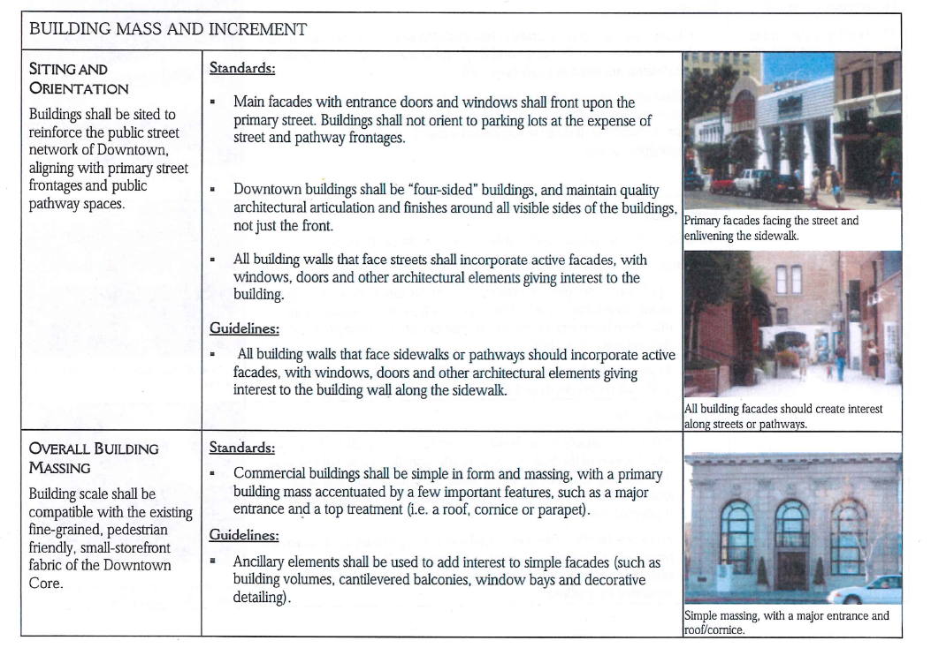
Design Standards
Cal Cities 2023: Planning Commissioners Academy Planning Commission 101
Notes:
So next we are going to walk through a project approval
Intent: On left side
Standards: Required, measurable
Guidelines: Nice to have and flexible based on the situation. Use Intent to clarify how to apply Guidelines
Notice the 3rd standards about street-facing facades.

Slide 19
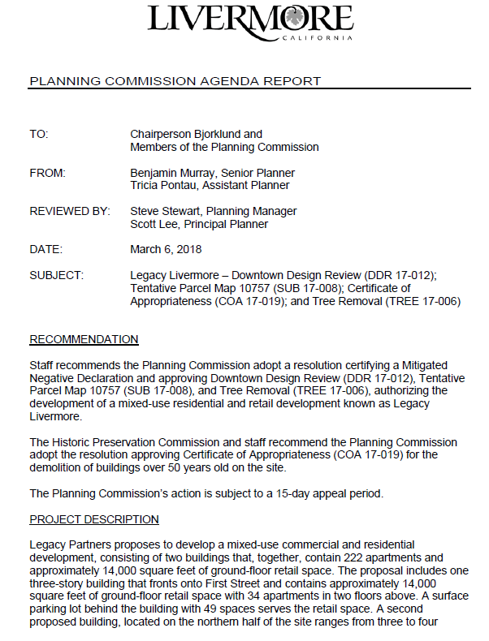
Staff
Report
Cal Cities 2023: Planning Commissioners Academy Planning Commission 101
Notes:
Here is a typical Planning Commission Staff Report for a project in Livermore.
Explain Sections.

Slide 20
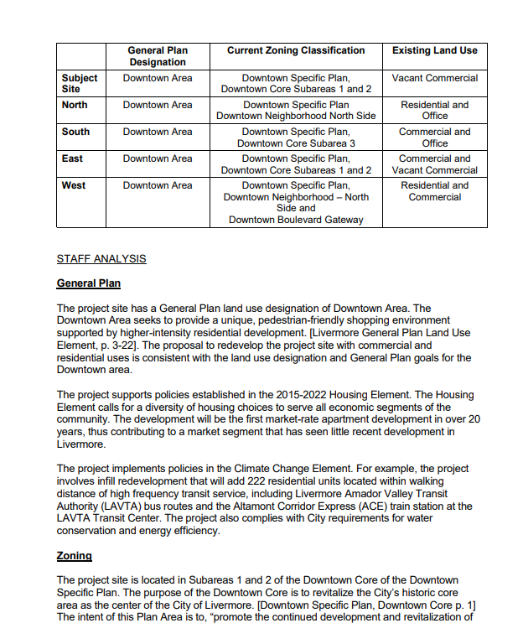
Staff
Report
Cal Cities 2023: Planning Commissioners Academy Planning Commission 101

Slide 21
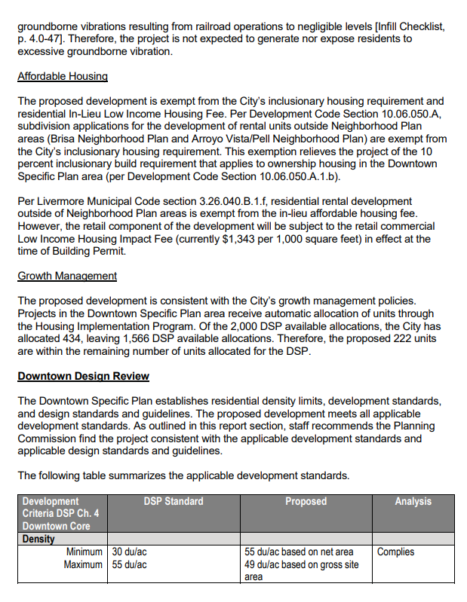
Staff
Report
Cal Cities 2023: Planning Commissioners Academy Planning Commission 101

Slide 22
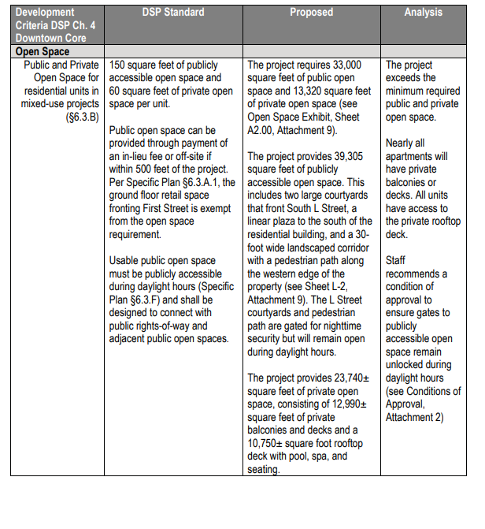
Staff
Report
Cal Cities 2023: Planning Commissioners Academy Planning Commission 101

Slide 23
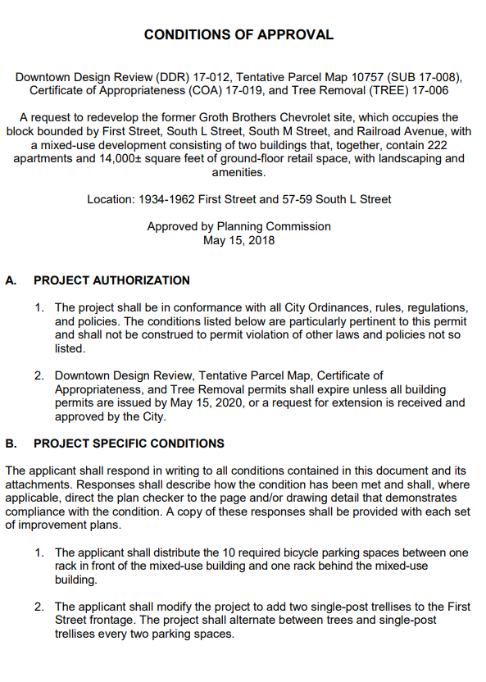
Staff
Report
Cal Cities 2023: Planning Commissioners Academy Planning Commission 101

Slide 24
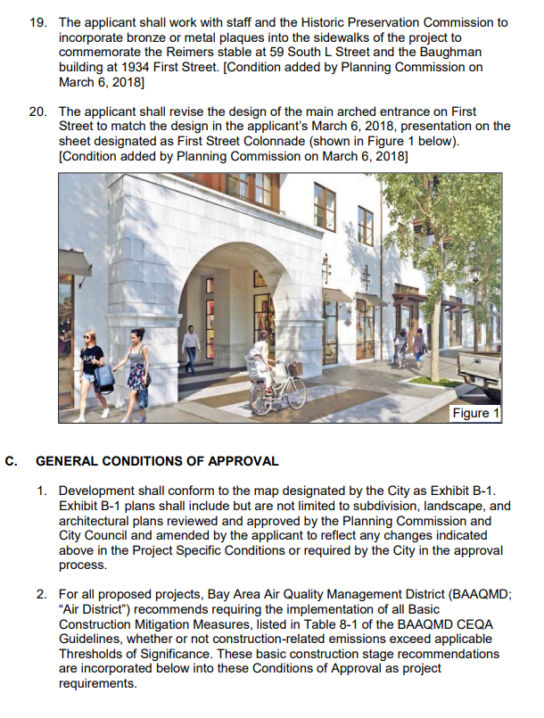
Staff
Report
Cal Cities 2023: Planning Commissioners Academy Planning Commission 101

Slide 25
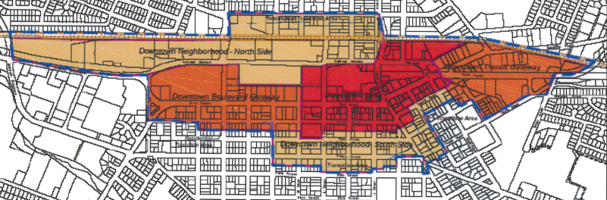
Downtown Specific Plan
Downtown Core
Subarea 1
Mixed-Use Required
Three floors, 45-foot maximum height
Subarea 2
Multi-Family Residential
Four floors, 55-foot maximum height
Cal Cities 2023: Planning Commissioners Academy Planning Commission 101
Notes:
The project is located in Subareas 1 and 2 of the Downtown Core area of the Downtown Specific Plan.
The Downtown Specific Plan intends for the core to be the heart of Livermore – a lively and densely developed mixed-use core.
Subarea 1 applies to development along First Street and requires mixed-use development at heights up to three stories.
Subarea 2 fronts Railroad Avenue and allows heights up to four stories.
Both subareas permit densities up to 55 units per acre
The applicant has designed the project to fully meet the land use and development standards of the Specific Plan. This includes building setbacks that clearly define the public street edge yet buffer the building edge, building heights that are lower than the maximums allowed, and public and private open space that meets the required standard onsite.

Slide 26
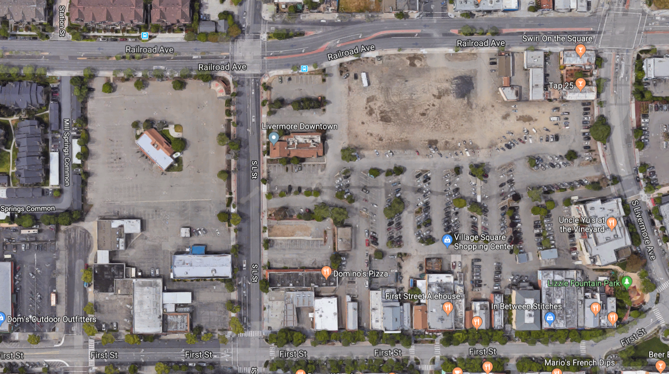
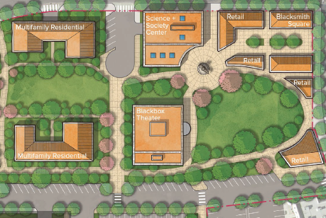
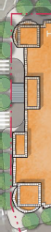
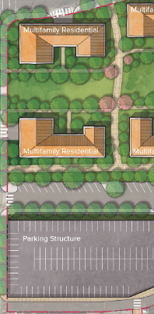
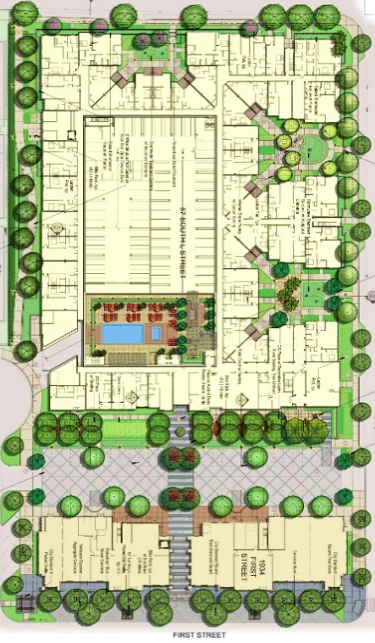
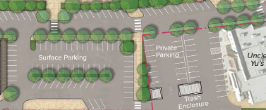
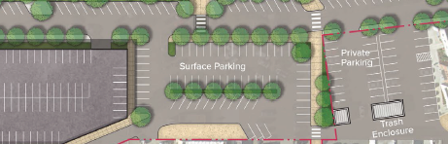
Proposed Project
Cal Cities 2023: Planning Commissioners Academy Planning Commission 101
Notes:
On January 30th, the City Council adopted key elements of a redevelopment plan for the former Lucky’s site immediately east of the site.
This slide illustrates the conceptual site plan for the redevelopment.
Some of the key elements include an east-west street and an adjacent tree-lined pedestrian spine, which will align with a courtyard on the Legacy site.
On the western half of the site, the plan anticipates multi-family workforce housing and a multi-level parking structure.
The housing will range from three to four stories and the parking structure will be four stories, creating a logical transition to the three to four-story Legacy development.
The conceptual residential massing interfaces well with the Legacy project. The height of the buildings also will be compatible.

Slide 27
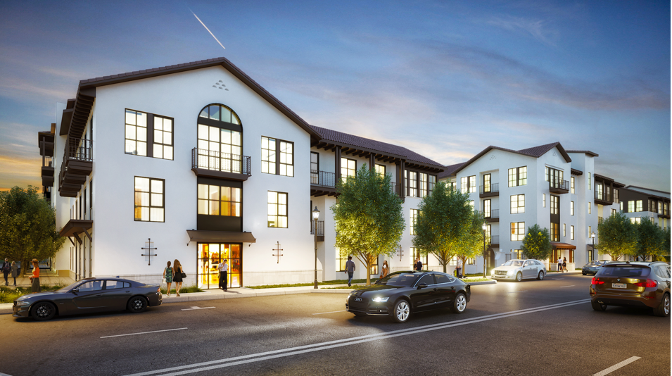
Architecture
Cal Cities 2023: Planning Commissioners Academy Planning Commission 101

Slide 28
Cal Cities 2023: Planning Commissioners Academy Planning Commission 101

Slide 29
Cal Cities 2023: Planning Commissioners Academy Planning Commission 101

Slide 30
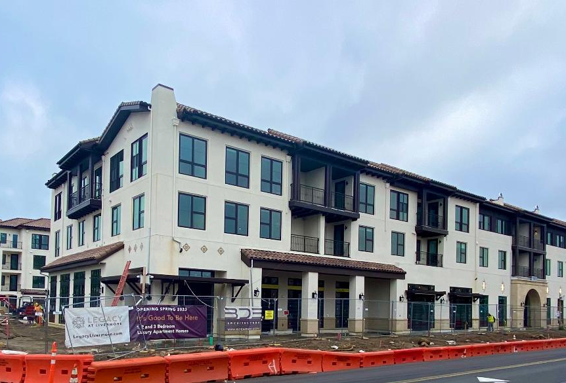
Cal Cities 2023: Planning Commissioners Academy Planning Commission 101

