Slide 1
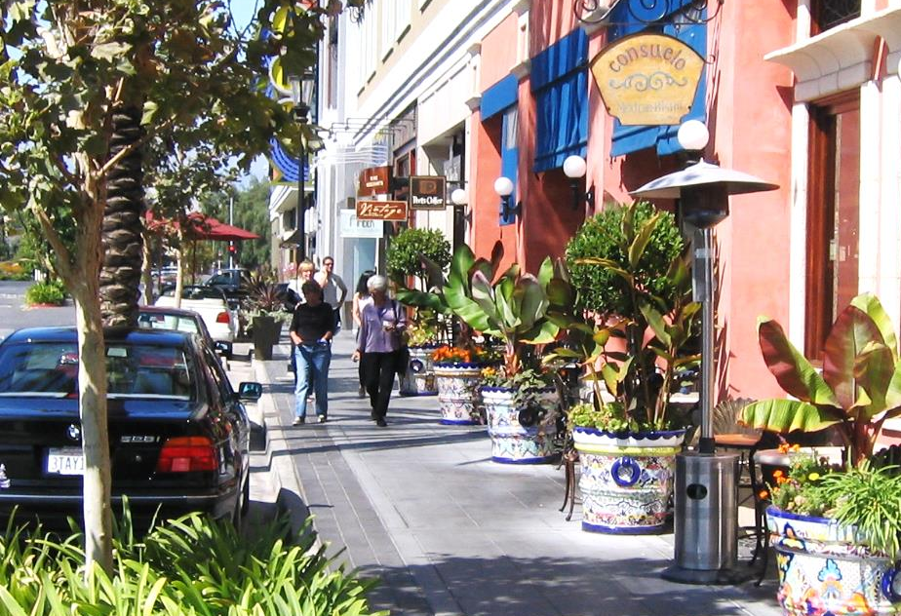
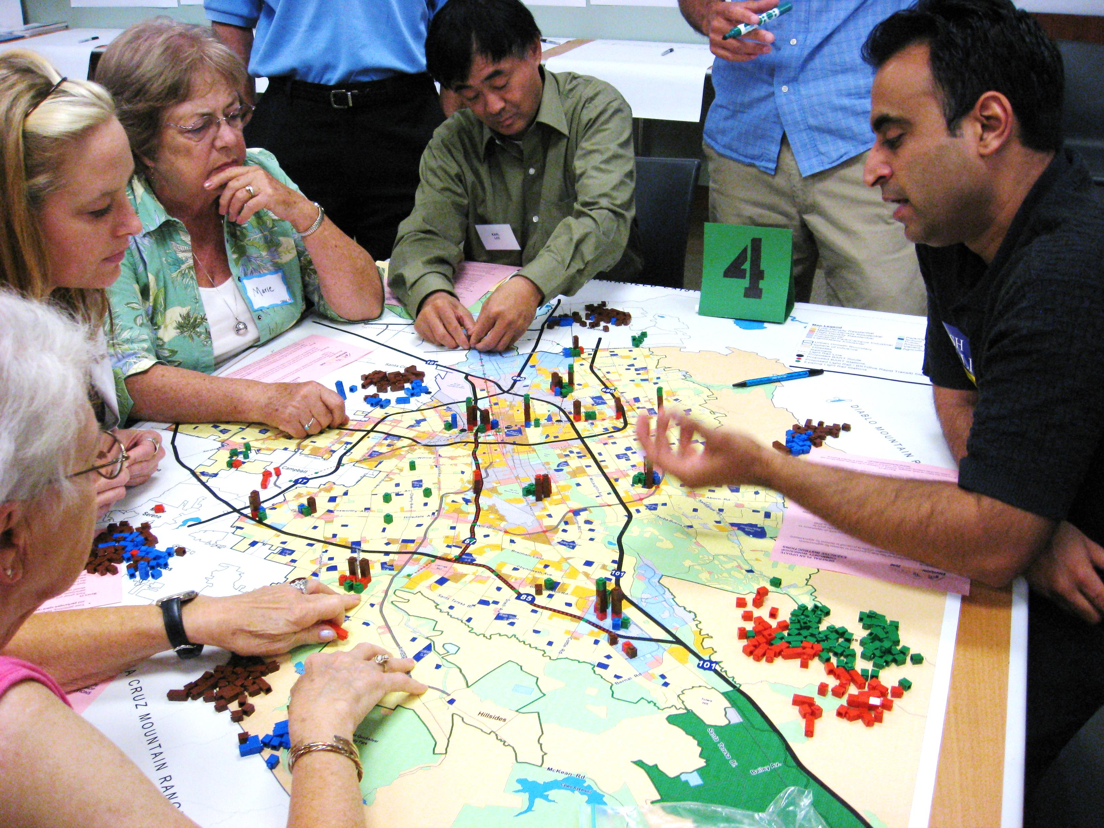
Planning Commission 101: The Nuts and Bolts of Planning
Cal Cities 2022: Planning Commissioners’ Academy | March 29. 2023

Slide 2
Panelists
David Early, AICP, Senior Advisor, PlaceWorks
Marc Roberts, Former City Manager, City of Livermore
Don Anderson, Planning Commissioner, City of Westminster

Slide 3
My Topics
Source of Power to Regulate Land Use
General Plans
Zoning
California Environmental Quality Act (CEQA)
Role of the Planning Commission

Slide 4
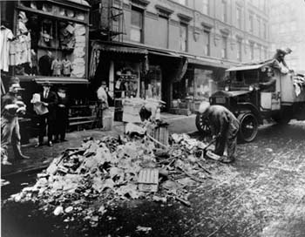
Land Use Regulation
Arose from “good government” movements as a response to unsanitary urban conditions
Embodied desire to rein in private market excesses through government regulation
Based on local government’s Police Power: health, safety and welfare

Slide 5
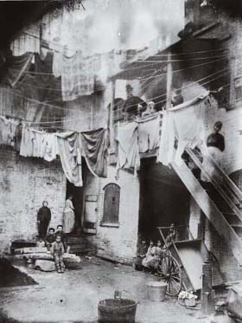
Key Milestones -- Nationwide
1909 Los Angeles imposes first zoning ordinance limiting industrial uses (not comprehensive)
1916 New York imposes first comprehensive zoning ordinance
1922 Standard State Zoning Enabling Act (SZEA)
1926 Euclid v. Ambler – upholds constitutionality of zoning

Slide 6
Key Planning Milestones -- California
California has long been a leader in planning and land use regulation:
1927 California passes law requiring that cities and counties have a Master Plan
1928 Standard City Planning Enabling Act (SPEA)
Zoning and planning laws have changed faster in California than the rest of the country due to rapid growth

Slide 7
Land Use Regulation Today
Only two plan types are defined in California law:
General Plans lay out a jurisdiction's future development plans through a series of policy statements in text and map form
Specific Plans are a special set of development standards that apply to a particular geographical area
Zoning provides detailed land use and design regulation.
Other planning documents include Master Plans, Area Plans, Vision Plans, etc., but these are not defined in the law.

Slide 8
Policy Plans and Regulations
Long-Term
GENERAL PLAN
Specific Plans
Coastal Plans
Zoning
Design Guidelines
More General
Sub-
division
Maps
Develop-
ment
Permit
Conditional
Use
Permits
Variances
Capital
Improve-
ments
Short-Term
More Detailed

Slide 9
General Plans
Bedrock of California planning.
Required by State Law
The “constitution” for planning, development and conservation
Provides long-range vision (20-30 year horizon)
Basis for local land use decisions and other policies
Identifies important community issues
Sets the ground rules

Slide 10
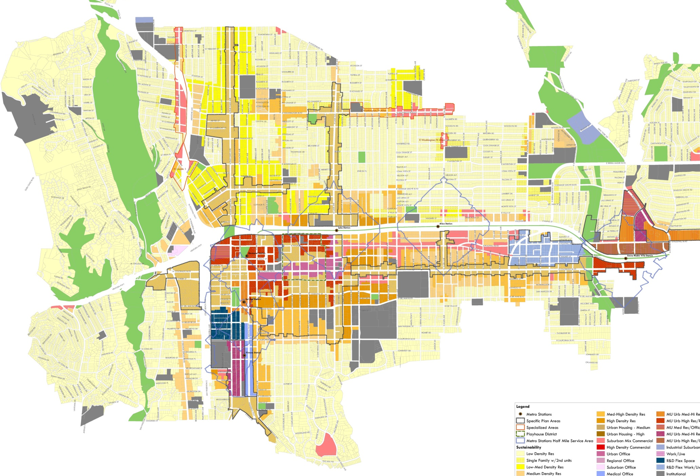
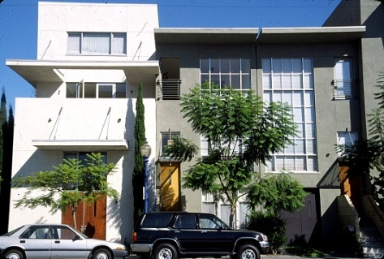
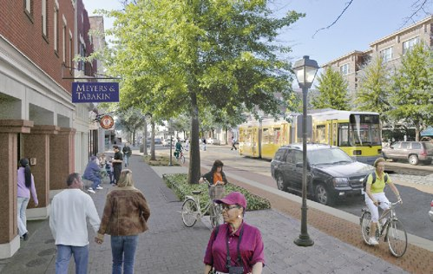
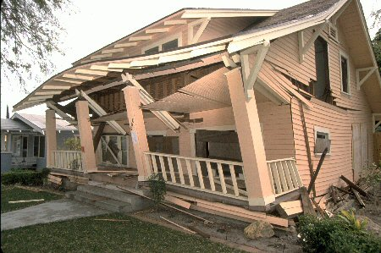
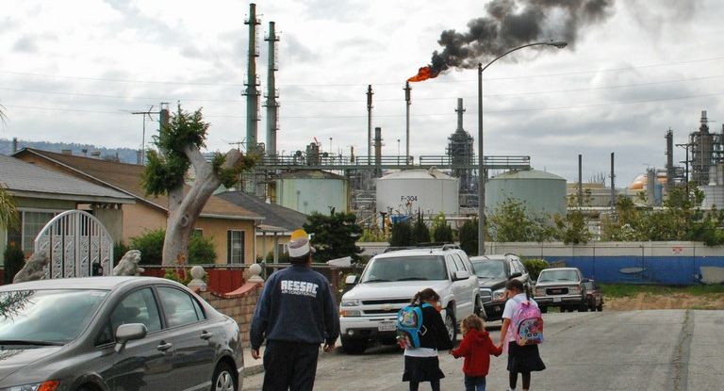
Required General Plan Elements
LAND USE
HOUSING
CIRCULATION
CONSERVATION
OPEN SPACE
NOISE
SAFETY
AIR QUALITY
ENVIRONMENTAL JUSTICE
Notes:
AQ Image: https://publichealth.llu.edu/about/blog/air-quality-california-steps-help-reduce-air-pollution
EJ Image: https://www.hcn.org/articles/pollution-a-new-generation-of-activists-born-next-to-an-oil-refinery

Slide 11
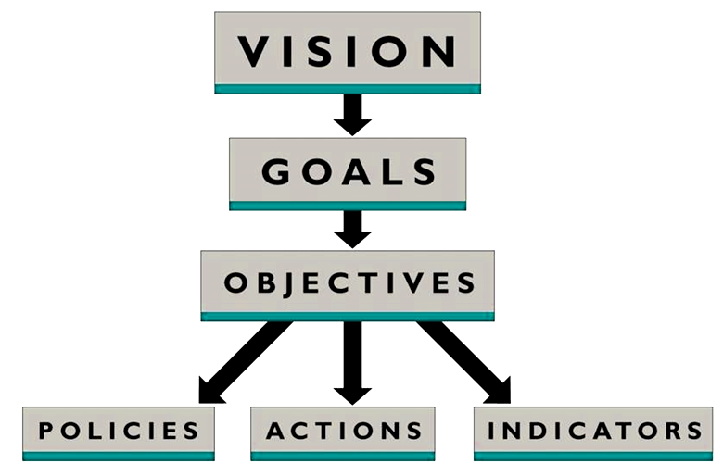
General Plan Content

Slide 12
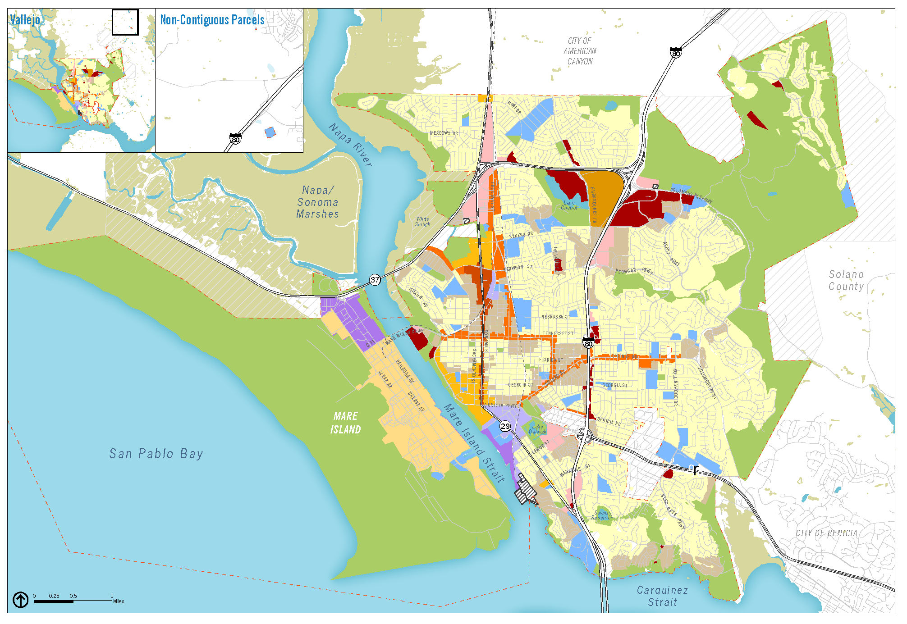
Typical General Plan Land Use Plan

Slide 13
Typical General Plan Circulation Map

Slide 14
Housing Element
Updated based on schedule in State law (4 or 8 years)
Certified by the State’s Department of Housing and Community Development
Annual report to the State on implementation
Required Contents
Regional Housing Needs Assessment (RHNA)
Housing need by income category
Specific sites zoned for housing at appropriate densities
Policies to facilitate housing development
Actions to remove barriers to housing production
Notes:
14

Slide 15
Zoning
Ordinance that implements and is consistent with General Plan policies
Prescribes allowable land uses and development standards including:
Building uses.
Building size (height, lot coverage and setbacks).
Landscaping.
Signs and billboards.
Parking requirements.
Other performance standards.

Slide 16
Zoning
Traditional “Euclidean” Zoning
Based on identification and separation of uses.
Focuses on:
Uses
Intensity
Setbacks
Less emphasis on building form

Slide 17
Form Based Zoning
Based on building form and design.
Focuses on:
Building design and mass.
Building scale, type and context.
Relationship of buildings to public space.
Design of streets and public realm.
Key Components
Building form.
Building frontage.
Building type.
Roadways.
Public spaces.
Architectural detail.

Slide 18
California Environmental Quality Act (CEQA)
Goals
Inform decision-makers about environmental effects.
Identify ways to avoid environmental damage.
Prevent avoidable environmental damage.
Disclose to the public why a project is needed, even if it results in environmental damage.

Slide 19
Types of CEQA Documents
Exemption
Available when project meets one of many criteria found in State law
Negative Declaration (ND)
If project found to have no significant effect on the environment.
Mitigated Negative Declaration (MND)
Specifies revisions to project plans that can avoid or mitigate effects.
Environmental Impact Report (EIR)
If project would have significant effects that cannot be eliminated through redesign or mitigation.

Slide 20
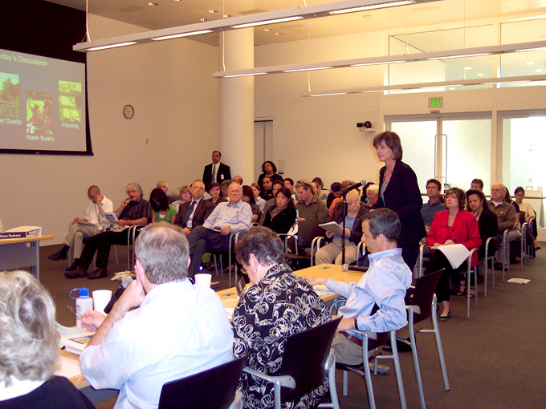
Role of the Planning Commission
Long Range Planning:
Creation and Amendment of Plans and Regulations
Current Planning:
Only for Discretionary Projects
No role for Ministerial Projects
For Discretionary Current Planning Projects:
Project Review
CEQA Review
Project Approval

Slide 21
Thank You!
David Early
dearly@placeworks.com
Cal Cities 2023: Planning Commissioners’ Academy | March 29, 2023

