Slide 1
Week of Action December 13-17, 2021
CDPH is hosting a Week of Action to celebrate the one-year anniversary of COVID-19 vaccines and to recognize the millions of Californians that have been vaccinated.

Slide 2
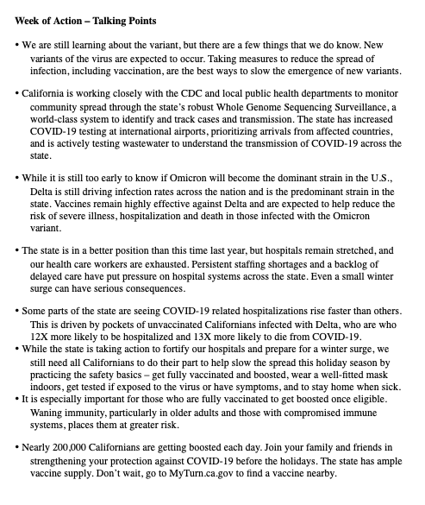
TALKING POINTS
Find the latest talking points (in English and Spanish) on boosters, variants, the winter season and more.
Box
Google Drive

Slide 3
SOCIAL GRAPHICS
It’s been a year since COVID-19 vaccines arrived in California!

Slide 4
Did you know that unvaccinated people are 13 times more likely to die from COVID-19?
Vaccines save lives.
Share these social graphics on Facebook and Instagram!
Box
Google Drive

Slide 5
ZOOM BACKGROUNDS
Use one of our colorful graphics as your background on Zoom (or any other video conferencing platform) all week long to help spread the word!
Box
Google Drive

Slide 6
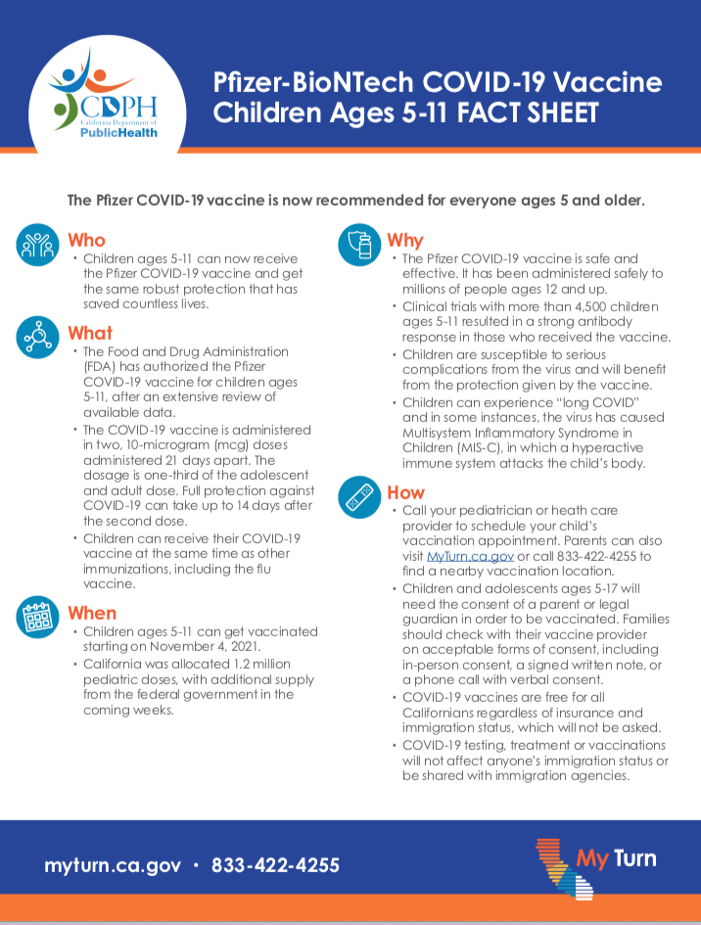
FACT SHEETS
Access fact sheets on:
Vaccines
Pregnancy and COVID-19
Variants
Box
Google Drive

Slide 7
AMBASSADORS
The Ambassador program is a resource that helps you reach out to families, friends and neighbors to encourage them to get vaccinated. You can share the animated videos from your phone or via social media!
Box
Google Drive

