Slide 1
Stopping Loitering in City Parks
COVID-19 Webinar Series
April 7, 2020

Slide 2
How to Ask a Question
All phone lines have been muted.
For written questions - use the Q&A window to the right side of your screen. Please enter your name, title and city.

Slide 3
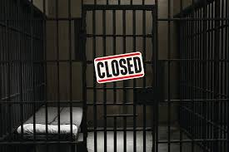
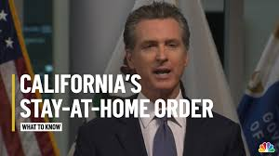
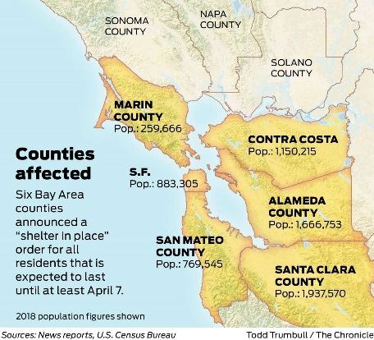
Erik Upson Police Chief City of Benicia
State Order
County Public Health Official
Local Orders
Definitions
Resources
Orders & Proclamations
Notes:
Discuss how each jurisdiction is unique
We don’t have all of the answers, and will likely bring up many questions to ponder
Example of 6 Bay Area Counties v. Solano County Public Health Official
Importance of Regional Approach – or you potential relocate problems
Definitions: Tightening up, but still room for interpretation (Essential Worker, Essential Business, ‘Exercise’, even the martial arts studio/child care example

Slide 4
Erik Upson Police Chief City of Benicia
CHALLENGES TO ENFORCEMENT
Who does the enforcement?
Police staffing and exposure concerns
Non-sworn enforcement challenges
Vague definitions
Lack of political support
Jail and Court issues
Regional issues
Notes:
Enforcement can’t just be a police issue, total team approach
One officer goes down it can bring down an entire team
Non-sworn without tools to protect themselves, but can be a voice to deal with compliant but ignorant or event stubborn but non-resistant
Nobody agrees entirely on the definitions. Conflicting statements between State/County/Local jurisdictions even amongst themselves. (Bloomberg piece “California’s Stay-at-Home Order is a Legal Mess”)
Political support for ACTUALY enforcing the orders…especially when it get’s ugly
Jails are trying to empty, concerned about bringing in virus, they can be relatively certain about the inmates they have but bringing in a new inmate is a risk. Courts shutting down, process grinding to a halt, most not prepared to move to virtual space
Regionally when one jurisdiction does something different than another there can be impacts. County/County City/City pushes problems around. State Parks/County Parks/Local Parks example.

Slide 5
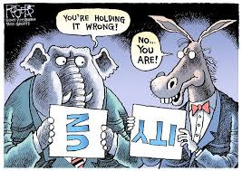
Erik Upson Police Chief City of Benicia
OPPORTUNTIES
CLEAR POLICY & UNIFIED TEAM APPROACH

Slide 6
Erik Upson Police Chief City of Benicia
OPPORTUNTIES
CPTED
CRIME PREVENTION THROUGH ENVIRONEMENTAL DESIGN
Resistant
Compliant
Stubborn

Slide 7
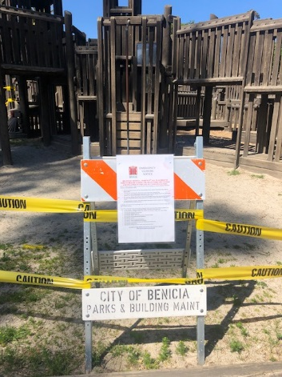
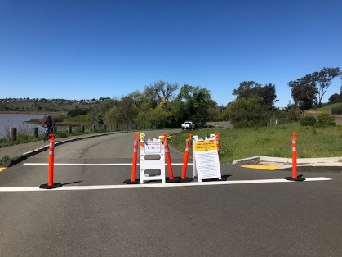
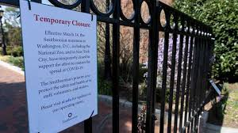
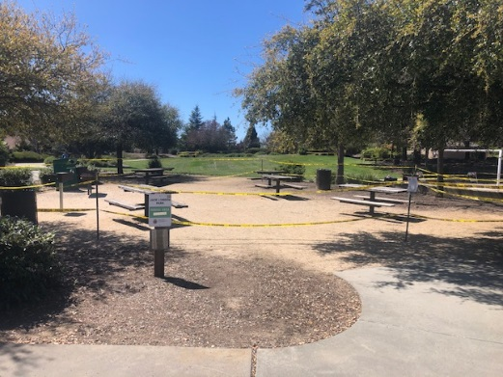
Erik Upson Police Chief City of Benicia
OPPORTUNTIES
CPTED
CRIME PREVENTION THROUGH ENVIRONEMENTAL DESIGN
Resistant
Compliant
Stubborn

Slide 8
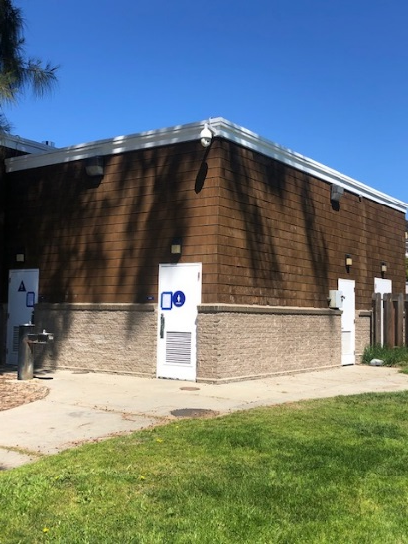
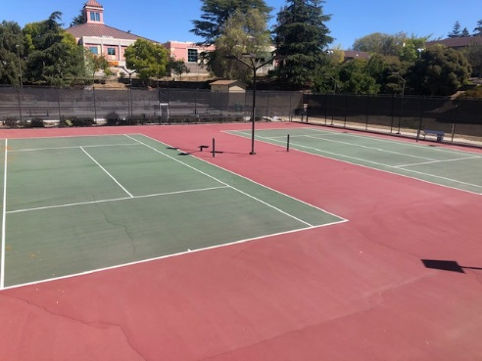
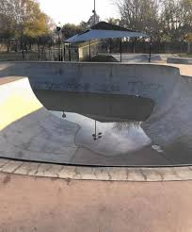
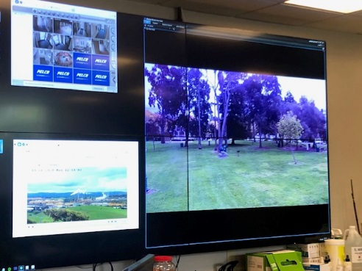
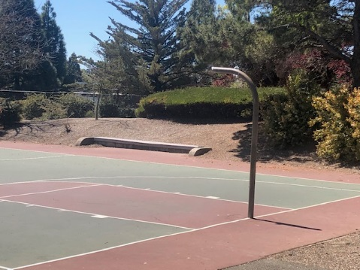
Erik Upson Police Chief City of Benicia
OPPORTUNTIES
CPTED
CRIME PREVENTION THROUGH ENVIRONEMENTAL DESIGN
Resistant
Compliant
Stubborn

Slide 9
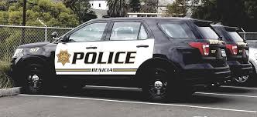
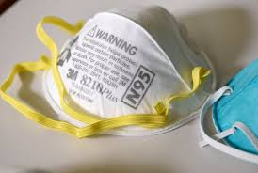
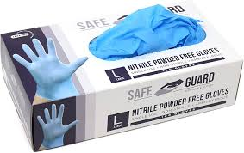
Erik Upson Police Chief City of Benicia
OPPORTUNTIES
CPTED
CRIME PREVENTION THROUGH ENVIRONEMENTAL DESIGN
Time
Patience
Communication
Resistant
Compliant
Stubborn
Notes:
Use Time, Patience and Communication in your approach.
Ask, Tell, Make.
Arrests should happen on your schedule.
Consider officer safety and potential for creating panic/unrest
Collaborate ahead of time to insure you have support for arrests under the Health and Safety Code violation with both the DA’s Office and your jail
Inure your staff have the appropriate safety equipment so they feel as confident as possible in making arrests. For instance, we are using Crime Scene Cleaners to decontaminate every care every week with a deep cleaning.
Consider Transportation issues ahead of time
You can’t take physical arrests off the table – watch your messaging. Some leaders have messaged that they won’t be making arrests. For us, it’s a last resort, but we absolutely will arrest you if we need to

Slide 10
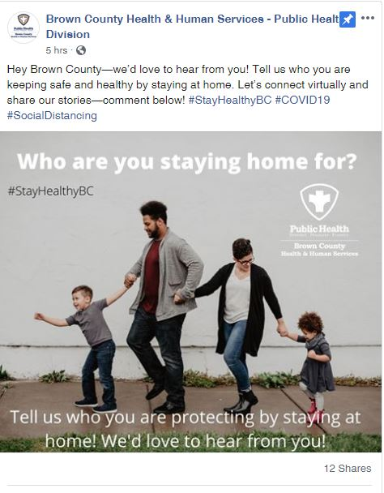
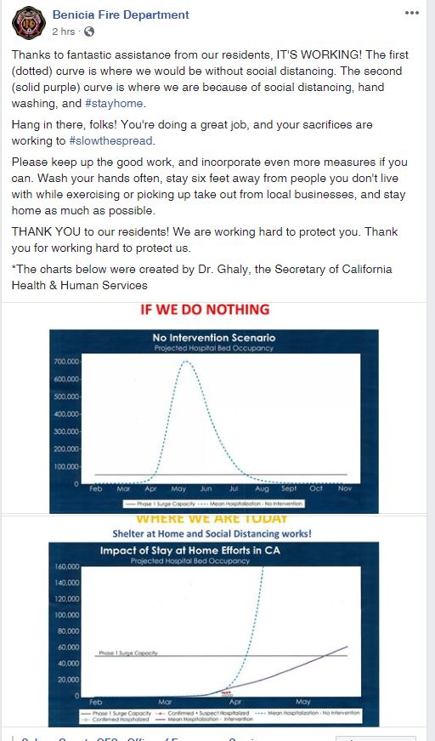
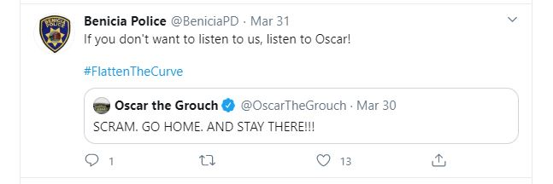
Erik Upson Police Chief City of Benicia
OPPORTUNTIES
SOCIAL MEDIA
Be relatable
Be visual
Be engaging

Slide 11
Andrew Greenwood Police Chief City of Berkeley
HOMELESS

Slide 12
Agenda

Slide 18
Questions?

