Slide 1

Case Study: Internet Service Providers (ISPs) Partnering with Cities to Enhance Connectivity in Cities

Slide 2
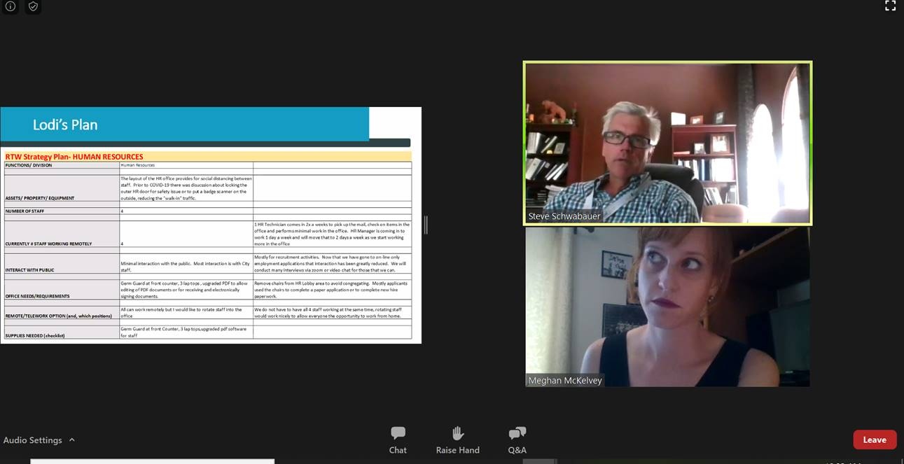
Housekeeping Notes
In order to hear today’s presentation, you must connect to the audio. You should have been prompted to connect your audio when joining the webinar, but you can confirm by clicking the audio settings on your tool bar.
This webinar is being recorded.
All attendees have been muted upon entry.

Slide 3
How to Ask a Question
To write in a question, select the ‘Q+A’ button on your tool bar. You can also “up vote” other attendee’s questions if you have interested in hearing the answer.
To verbally ask a question or make a comment, use the ‘raise hand’ feature on the tool bar at the bottom of the screen once the Q&A portion begins. You will be called on and unmuted.

Slide 4

Moderator:
Bismarck Obando, Director of Public Affairs, League of California Cities
Presenters:
Keri Askew Bailey, Group Vice President, State Government Affairs, Charter Communications
Sunne McPeak President and CEO, California Emerging Technology Fund
Antonia Castro-Graham, Deputy City Manager, City of Fullerton
Michael Santorelli, Director, Advanced Communications Law & Policy Institute, New York Law School

Slide 5
Introduction to
Charter Communications

Slide 6


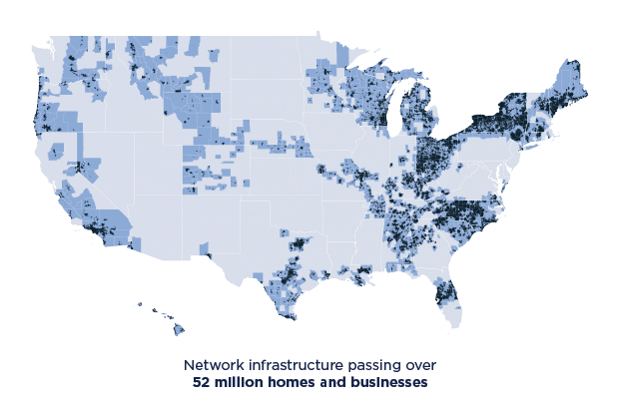
Charter Communications is a connectivity company providing broadband, video, mobile, and voice services in 41 states under the brand name Spectrum.
We’re driving innovation and expanding access to broadband to ensure our customers receive the information and entertainment they want and need to succeed in today’s hyper-connected world.

Slide 7



Providing Superior Products and Services to Meet Our Customers’ Needs
High Speed Broadband: Charter delivers some of the fastest starting speeds in the industry 200 mbps to 60% of the homes and businesses we serve — and 100 mbps nearly everywhere else. Spectrum Internet Gig delivers a 1 Gbps connection (940 Mbps maximum download) across virtually our entire footprint.
Charter is committed to expanding access to broadband connectivity, especially in rural communities. In the last three years alone we’ve invested more than $20 Billion in American infrastructure and technology and expanded our network to reach nearly 2.5 million new homes, businesses, about 1/3 of which are in rural areas
Smart Cities
Municipal leaders from across the country are recognizing the promise of smart city projects to improve the quality of life for their residents. A smarter city promises to be a better place for residents to live and work.
Public Right of Way and Permits
Charter’s local construction teams work closely with state and local officials to construct new network miles, restore network connections and enhance existing infrastructure to meet the connectivity needs of our customers.

Slide 8
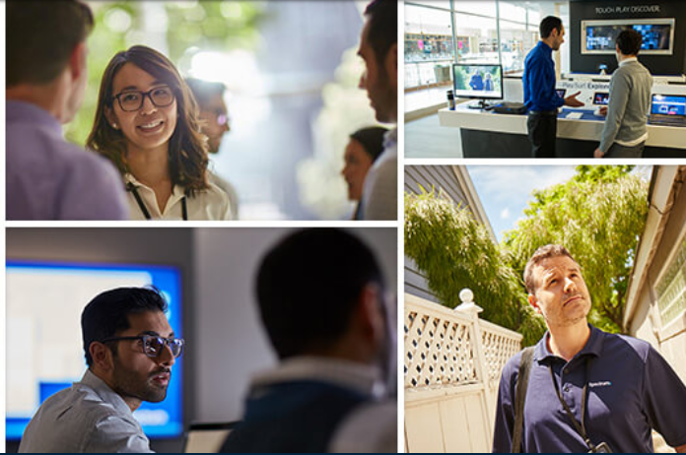
Our Workforce
Charter employs more than 8,900 people across California
Charter offers a $15 per hour minimum wage
Charter has committed to raise that minimum wage to $20 per hour in 2022
Highly regarded, Department of Labor-certified,
national Broadband Field Technician Apprenticeship Program
External Diversity & Inclusion Council (EDIC), an external group of accomplished leaders, advises Charter on how to best enhance diversity and inclusion
Offering employees robust healthcare benefits, generous retirement program including company match, and opportunities for job training and advancement

Slide 9
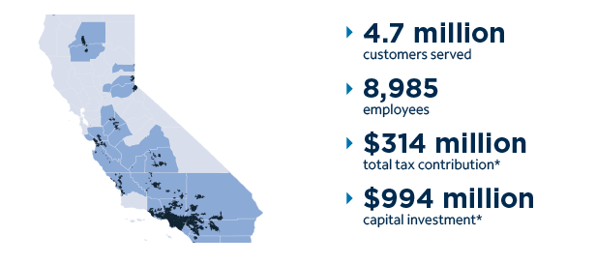
Our Impact in California
*1/1/2019 – 12/31/19 policy.charter.com

Slide 10


Charter is meeting the moment during the pandemic…
Connecting nearly 450,000 students, teachers, and their families to broadband service for 60 days at no cost (as of July 31, 2020)
Keeping around 700,000 customers with COVID-related financial impacts connected
Forgiving approximately $85 Million in overdue balances for customers with COVID-related financial impacts
Supporting our workers by:
  Increasing wages by $1.50 per hour for front line workers (February, 2020) and committing to a company-wide $20/hr minimum wage in 2022
  Providing workers with 15 additional days of paid time off in 2020 for COVID-related impacts
Supporting Small Businesses, Charter provided a month of free services to new business customers working to reopen after the first phase of the pandemic
Notes:
Image: Picture of urban & rural environment?

Slide 11
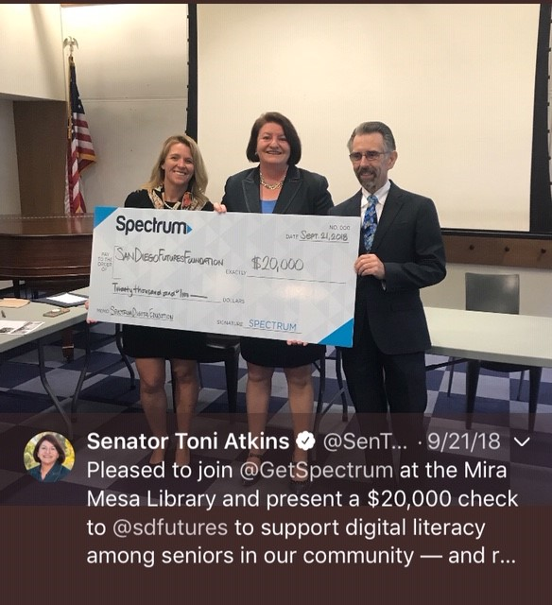
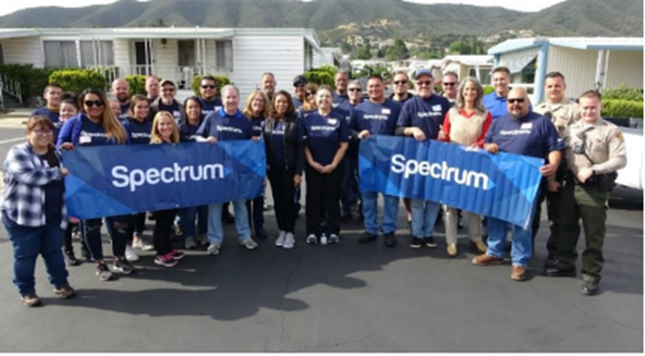
Strengthening Our Communities
Spectrum Internet Assist
Charter’s Spectrum Internet Assist (SIA) is available to eligible households. This low-cost broadband option for eligible families and seniors delivers the fastest speeds of any comparable industry offering (30/4 Mbps), which meets and even exceeds the FCC’s definition of high-speed broadband.
Spectrum Digital Education Grants
Charter is helping close the digital literacy gap by supporting nonprofit organizations that educate community members on the benefits of broadband and how to use it to improve their lives – awarding over
$1.5 million to nonprofit organizations since 2017.
Investing in Minority-Owned Small Businesses: To support minority-owned small businesses in underserved communities, Charter is partnering with the National Urban League and National Action Network on a $10 million investment to increase access to much-needed low-interest capital and help build thriving communities across the country.
Spectrum Employee Community Grants:
Charter donated $500,000 to employee-supported organizations across the country in 2019.

Slide 12

For more information:
Keri Askew Bailey, Group Vice President
State Government Affairs - West
Keri.AskewBailey@charter.com https://policy.charter.com

Slide 13

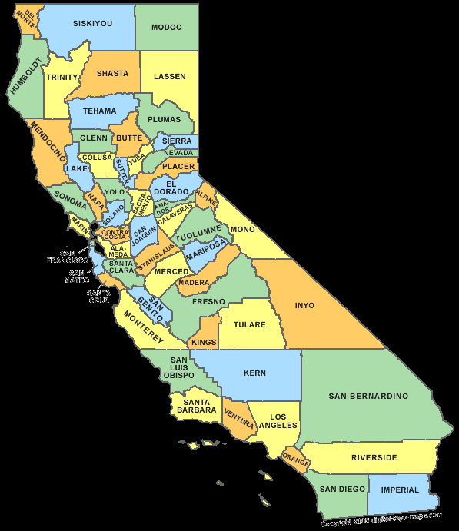









League of California Cities
Charter Communications
January 20, 2021

Slide 14
2019 Statewide Survey Results

Slide 15
2019 Statewide Survey Results

Slide 16

League of California Cities
Charter Communications
January 20, 2021

Slide 17
League Of California Cities
ISPs Partnering with Cities to Enhance connectivity in cities
City of Fullerton – Fiber city
Smart Cities initiative
Antonia Graham, deputy city manager

Slide 18

What is a smart city?
A City can be defined as “smart” when investments in human and social capital and traditional and modern communication infrastructure fuel sustainable economic development and a high quality of life.
At the end of the day, a smart city is a city that works for everyone, that uses technology to improve business services, to make life better for its residents, and for improving its own functions.
Notes:
IMAGINE A CITY WHERE...
The daily commute is shortened by 15-30 minutes.
Emergency response times are cut by 25-30 percent.
Time spent interacting with healthcare and government is reduced by 45-60 percent.
100 percent of your community’s students have access to digital education tools.
Water consumption is lowered by as much as 20–30 percent.
Digital communities drive increased citizen engagement.
A smart city delivers intelligent capabilities and improves quality of life for its constituents by using technology to respond, in real-time, to its ever-changing environment. A smart city can have a profound impact in areas such as economic development, transportation, utilities and public safety. Together, we can improve the lives of those who live, work and play in your community, making the possibility of progress achievable for all.

Slide 19

Smart city challenges
The development of smart city confronts several challenges from the technological perspective.
  Preserving privacy of citizens and end users is a big concern since most of the frameworks require collecting data from its citizens.
  Challenges related to data storage
  On-device and embedded intelligence to support IoT and resource constrained devices that build the city infrastructure.

Slide 20
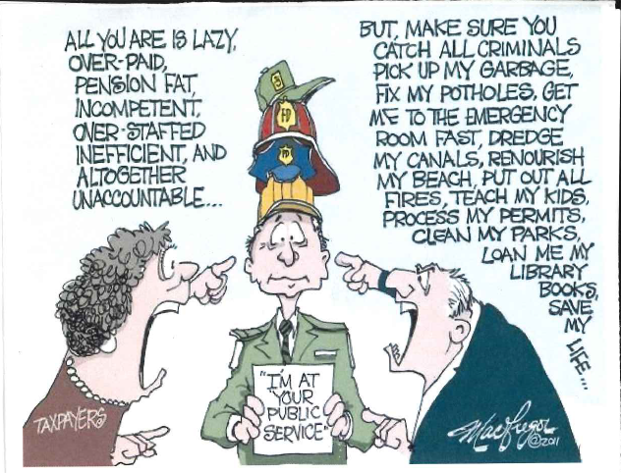
Why this matters for your Community?
Everyday leaders grapple with knotty, complex problems like decaying public infrastructure, aging utilities, urban blight, neighborhoods that are vulnerable to climate change, and other multi-faceted socio-economic challenges.
City Council may ask why is this important?
Residents want FREEMIUM services!

Slide 21
What's happening in Fullerton
Fullerton Fiber City
Expedited Permitting
Wireless/Telecom Ordinance
Partnerships with Spectrum

Slide 22


https://sifinetworks.com/cities/fullerton-ca/
In 2013, Sifi approached the City after our bid to attract Google Fiber did not succeed.
In 2014, the City entered into a Master Development Agreement with Sifi to construct a privately funded Fiber-to-the-Home (FTTH) network
Construction began in late 2019
Funded by the Smart City Infrastructure Fund
Two ISPs have committed – Ting and Gigabit Now

Slide 23
Partnerships with spectrum
Spectrum has been a great community partner
Robust fiber network within the City
During the COVID crisis the City has relied more on the PEG channel to get information out and increase transparency
Spectrum worked with the City to get the word out about the Spectrum Assist program.

Slide 24

Questions
Antonia Graham agraham@cityoffullerton.com

Slide 25


Partnering with Cities to Enhance Broadband Connectivity
League of California Cities
January 20, 2021
Michael J. Santorelli
Director, Advanced Communications Law & Policy Institute
New York Law School
michael.santorelli@nyls.edu

Slide 26
The ACLP at New York Law School
Mission. To provide local, state, and federal policymakers with usable, data-driven analyses regarding the array of legal, regulatory, and public policy issues impacting broadband connectivity.
Focus. Both sides of the connectivity equation matter.
  Supply-side issues: availability, rural challenges, infrastructure policy, spectrum, etc.
  Demand-side issues: barriers to more robust broadband adoption & use
Process. The program’s research and writing is grounded in:
  Gathering and presenting actual data re broadband connectivity and trends;
  Evaluating (using data) the efficacy of approaches/models/projects focused on enhancing broadband connectivity; and
  Developing practical recommendations based on the data.

Slide 27
How to Ask a Question
To write in a question, select the ‘Q+A’ button on your tool bar. You can also “up vote” other attendee’s questions if you have interested in hearing the answer.
To verbally ask a question or make a comment, use the ‘raise hand’ feature on the tool bar at the bottom of the screen once the Q&A portion begins. You will be called on and unmuted.

Slide 28
Final Thoughts
Find session materials at https://www.cacities.org/Top/Partners/League-Partner-Webinar-Series

