Slide 1
California Highway Patrol Organized Retail Crime Task Force
Captain Jason Daughrity
City Leaders Summit, April 13, 2023
Strategies for Local Governments To Prevent Organized Retail Crime

Slide 2
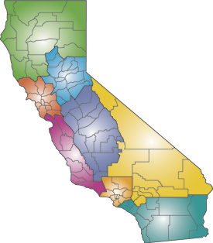
NORTHERN
DIVISION
VALLEY
DIVISION
CAPITOL
DIVISION
CHP REGIONAL
DIVISIONS
GOLDEN GATE
DIVISION
CENTRAL
DIVISION
COASTAL
DIVISION
INLAND
DIVISION
SOUTHERN
DIVISION
BORDER
DIVISION

Slide 3
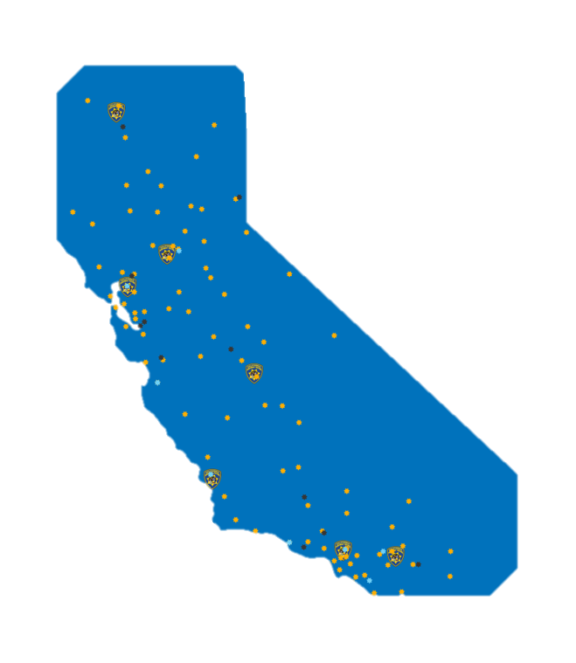
3 Regional Teams
Southern Division
Border Division
Golden Gate Division

Slide 4
2 Expansion Teams
Valley Division
Central Division

Slide 5
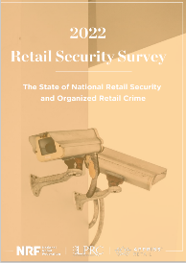
Top Cities/Metropolitan Areas Affected by ORC over the past five years…
NRF 2022 Survey
Los Angeles remains #1
SF/Oakland remains #2
Sacramento moved up to #7

Slide 6
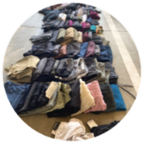
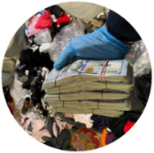
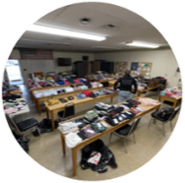
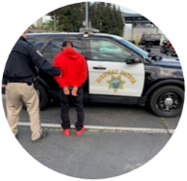
Since October 2019…

Slide 7
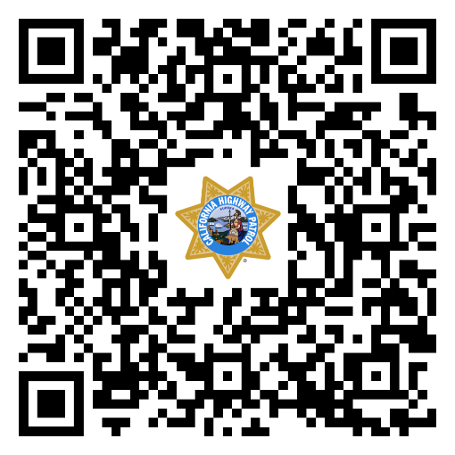
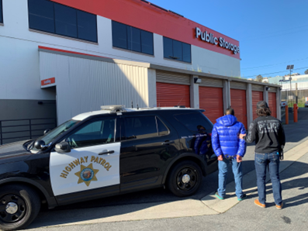
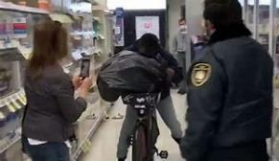
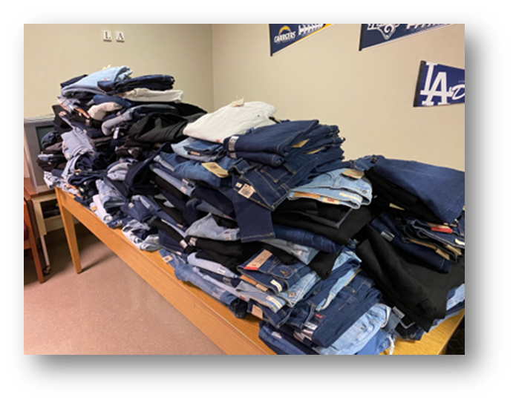
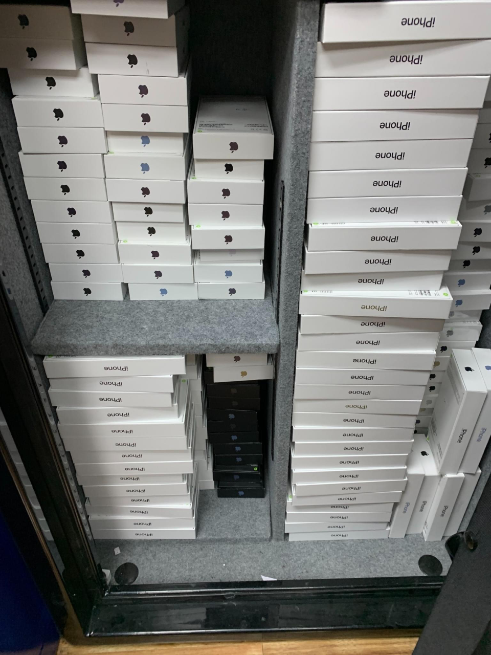
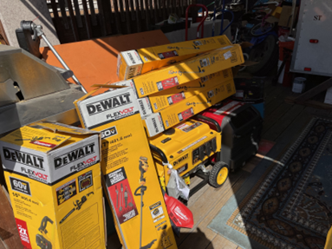
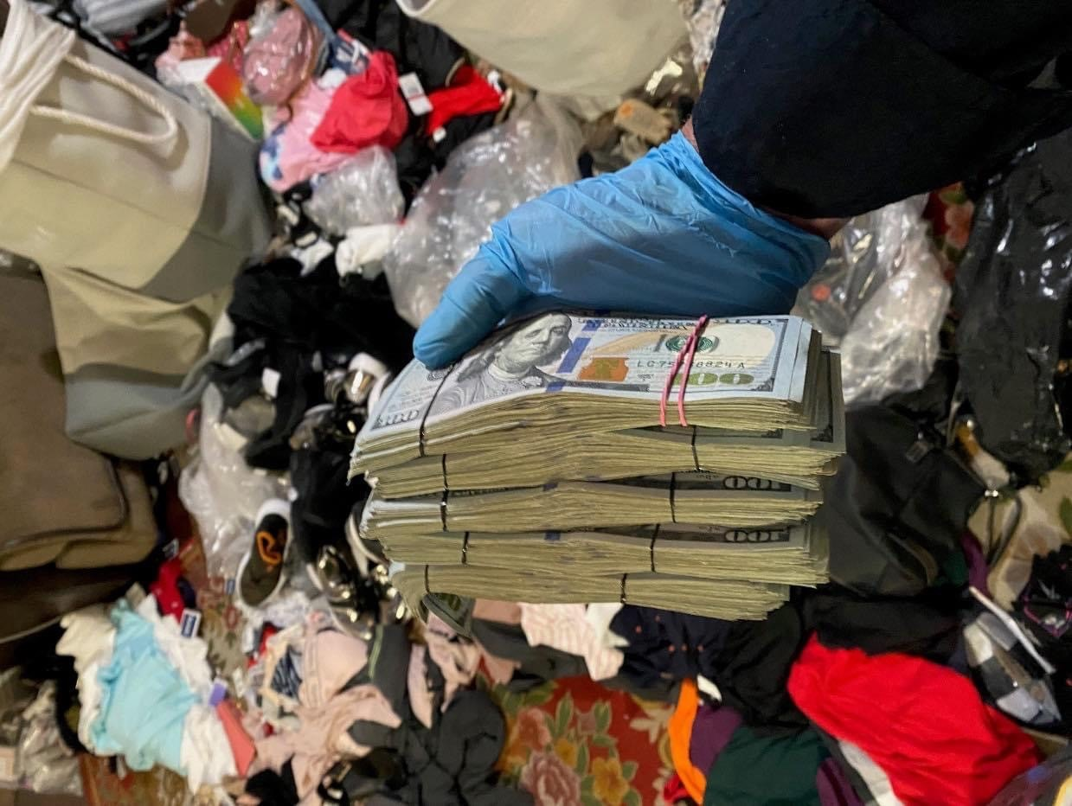
CHP Notify Organized Retail Theft Online Tip Portal
www.chp.ca.gov/notify-chp/organized-retail-theft-program

Slide 8
Mike Lamb
Manager of ORC &
Special Investigations

Slide 9
Organized Retail Crime

Slide 10
QUESTION? Is this Organized Retail Theft or Shoplifting?

Slide 11
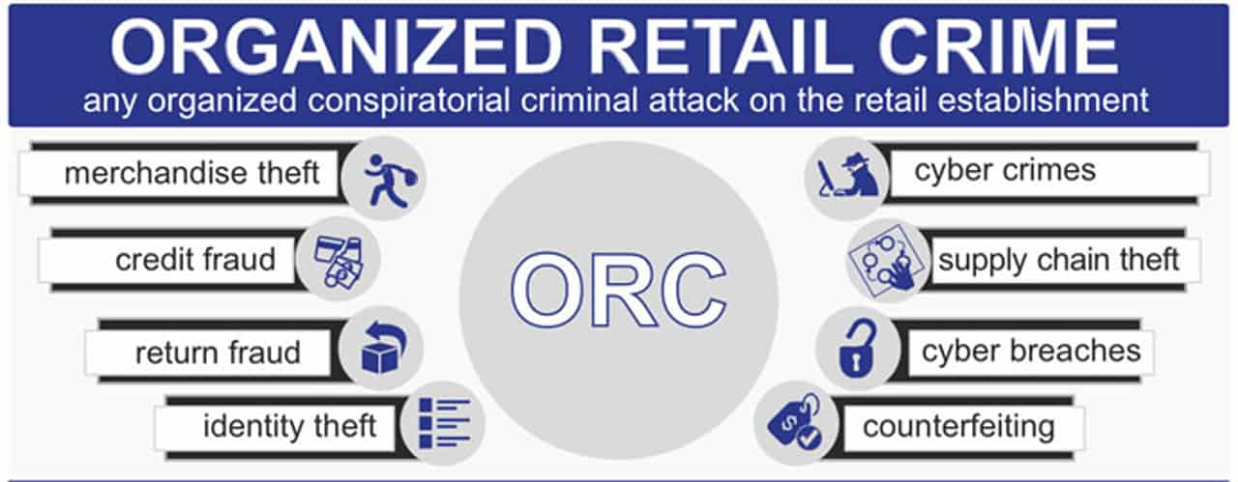
What is Organized Retail Crime?
Organized Retail Crime is criminal activity occurring within the retail environment that is planned and carried out by individuals in a systematic and repeated fashion
The most popular form of organized retail crime is professional shoplifting, however, it can also encompass cargo theft, financial fraud, burglary and robbery
Graphic from LPM Magazine

Slide 12
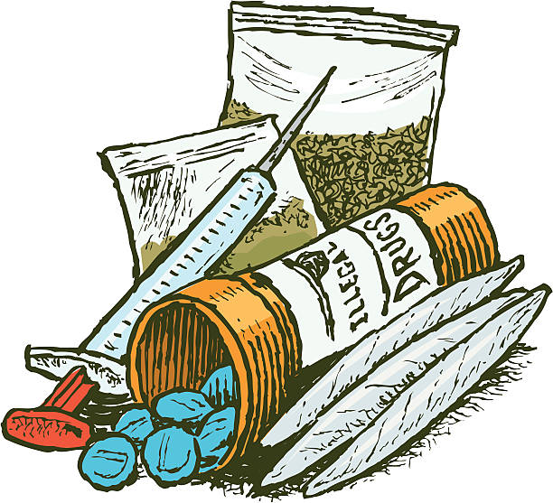
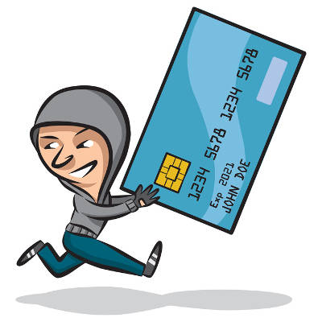
ORC Linked To Other Crimes
Oftentimes, these organized theft groups are linked to other crimes including narcotic trafficking, human trafficking, prostitution, and identity theft.
"Federal law enforcement has traced the illicit proceeds from retail crime, specifically from the theft and resale of infant formula, to terrorist organizations and insurgent groups, including Hamas and Hezbollah. For instance, following the terrorist attacks of 2001, the former U.S. Customs Service established Operation Green Quest—a now-defunct, multi-agency terrorist financing task force—to combat the various sources of terrorist financing; one such source was identified as the “theft, adulteration, and resale of infant formula.” "
- Congressional Research Service Report
Domestic Security Specialist Kristin Finklea

Slide 13
Who is committing this crime?
Criminal Organizations consisting of Boosters and Fences

Slide 14
Connection to Other Criminal Enterprises
House Judiciary Committee Subcommittee on Crime, Terrorism, and Homeland Security Washington, DC November 05, 2009 Statement by David Johnson, Section Chief, Criminal Investigative Division, Federal Bureau of Investigation
…’Boosters’ - the front line thieves who intend to resell stolen goods generally coordinate with ‘fences’ who may sell the items outright at flea markets or convenience stores or online, or repackage them for sale to higher level fences. The problem is significant for its negative economic impact, the safety issues it brings to unsuspecting consumers, and its potential link to other criminal enterprises….

Slide 15
ORC Offender Terminology
Shoplifter
A shoplifter is an opportunist thief who steals for personal consumption and or use.
Booster
A booster is an individual who shoplifts for the purpose of financial gain.

Slide 16
LOW LEVEL BOOSTER
Localized activity, usually works alone and is supporting a habit.
Typically have criminal backgrounds for various other crimes.
They see boosting as a LOW RISK, HIGH RETURN!!
Can average 25 cents on the retail dollar for stolen goods.
Average Daily Retail Impact = $200-$2000
Average YTD = $73,000 - $730,000
LOW-LEVEL BOOSTER

Slide 17
MID-LEVEL BOOSTER
Usually works with one or more accomplices
They are mobile and operate statewide and in neighboring states.
Will target numerous stores in a single day
Typically work for one or more fences to fill orders. Boosting is a job!!
Average Daily Loss = $2K-10K
Average YTD = $730,000 – 3,650,000
MID-LEVEL BOOSTER
LOW-LEVEL BOOSTER

Slide 18
HIGH LEVEL BOOSTER
Operate in large geographic areas as part of a structured group.
Will target countless stores daily and will travel for several weeks at a time.
Typically consolidate product in motel rooms to prepare the product for shipment to the fence
Affiliated with other groups all working for the same fence to move large amounts of stolen goods
Average Daily Loss = $10K-40K
Average YTD = $3 Million +
HIGH-LEVEL
BOOSTER
MID-LEVEL BOOSTER
LOW-LEVEL BOOSTER

Slide 19
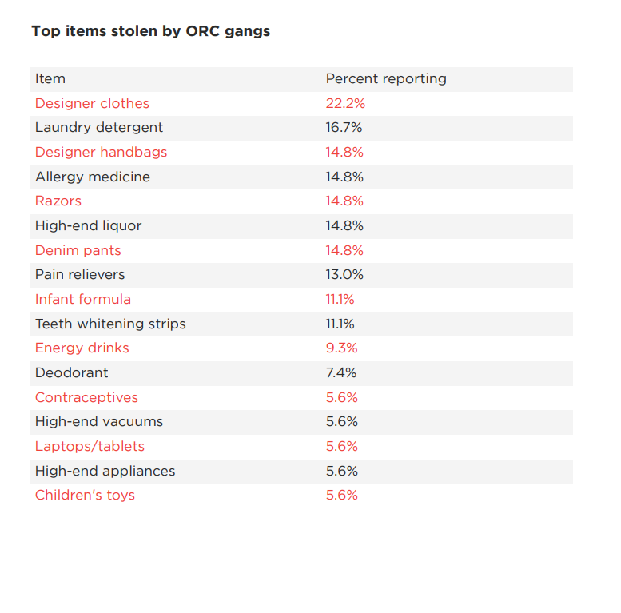
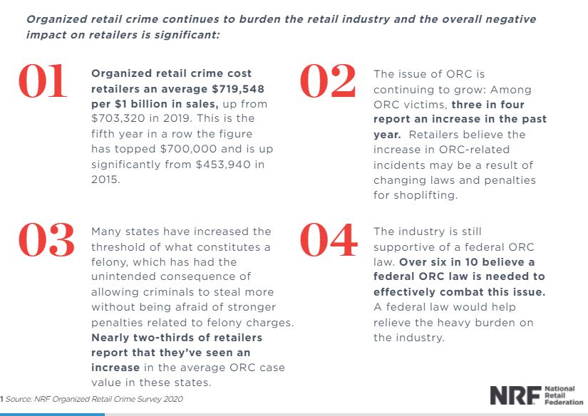
National Retail Federation Security Survey

Slide 20
ORC Reseller Terminology
Fence
An individual who knowingly and routinely purchases stolen merchandise.

Slide 21
LOW LEVEL FENCE
Usually operates out of a small business– grocery store, gas station, pawn shop, etc.
Purchase stolen goods from Low Level & Mid-Level Boosters daily.
May recruit and train boosters
Will “clean product” (remove labels)
May sell some of the product at the primary business location or online. Usually, will sell the product to a mid-level fence
LOW-LEVEL FENCE

Slide 22
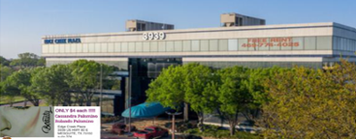
Low-Level Fence Location
Appears to be a legitimate business
May have 100+ booster visits per day
May move stolen product daily or weekly to Mid-Level Fence or at times a High Level Fence

Slide 23
MID LEVEL FENCE
Purchases stolen goods from Low Level Fences and Low & Mid-Level Boosters
May operate out of their residence, small business or warehouse
Usually re-sells the stolen goods to a High-Level Fence/Wholesaler or through e-commerce
Cleans and re-packs the stolen product
Money is often laundered to fund other illicit activities
MID-LEVEL FENCE
LOW-LEVEL FENCE

Slide 24
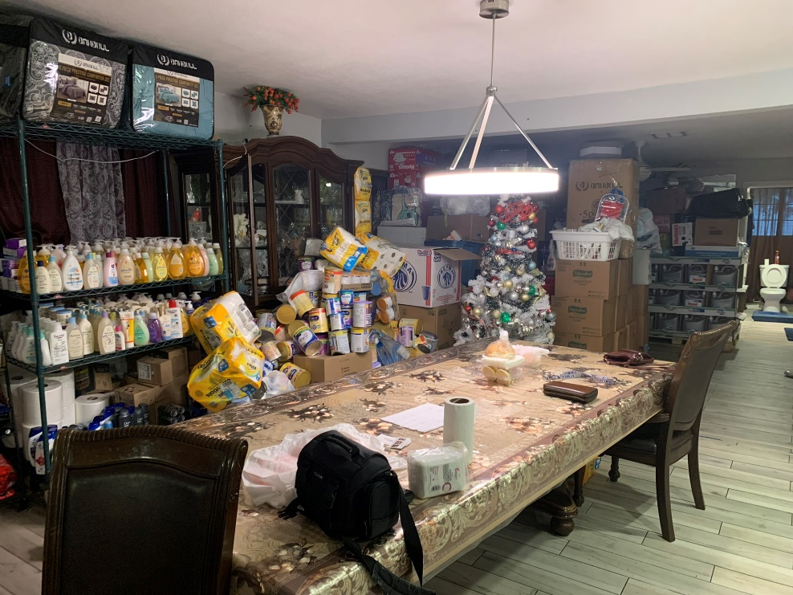
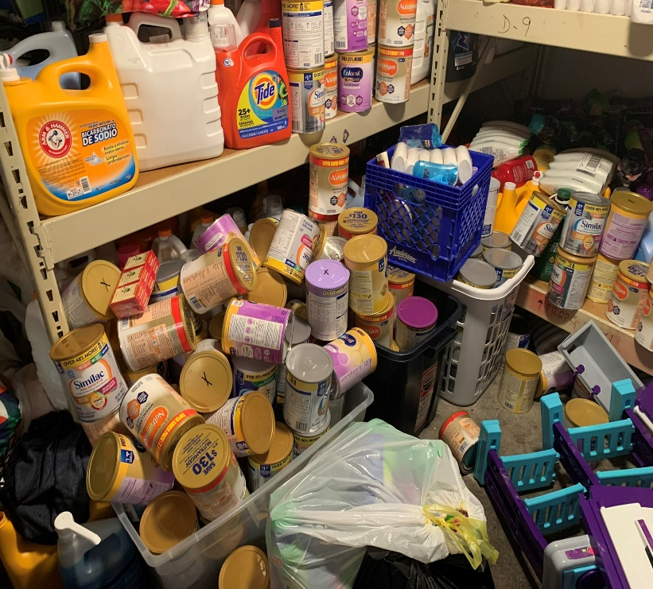
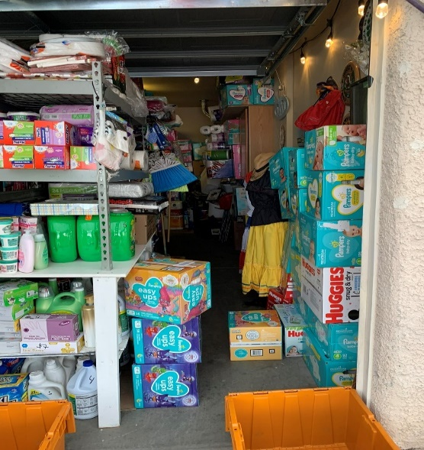
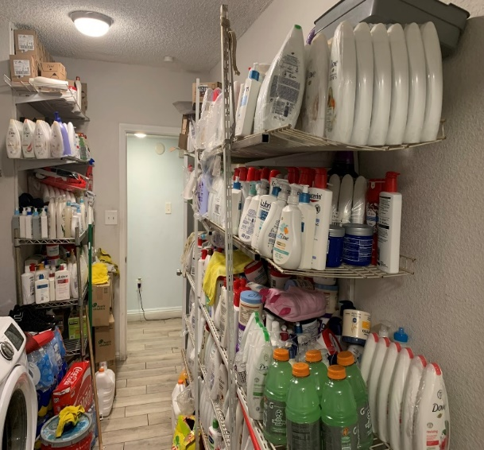
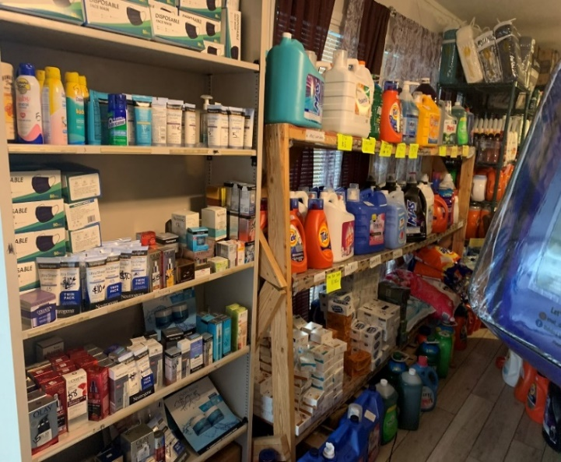
Mid Level Fencing Location

Slide 25
HIGH LEVEL FENCE
Typically operates as a wholesaler or warehouse operation
Will buy from Low & Mid-Level Fences and occasionally High-Level Boosters
Often intermingles legitimate and illicit goods to offset margin and increase profits
Usually sells to unsuspecting legitimate businesses
May launder currency or fund some special-interest group engaged in other types of criminal activity
HIGH-LEVEL
FENCE
MID-LEVEL FENCE
LOW-LEVEL FENCE

Slide 26
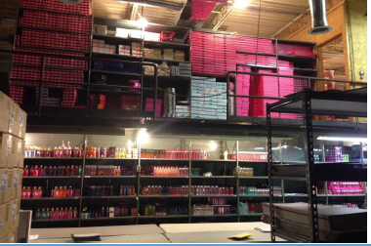
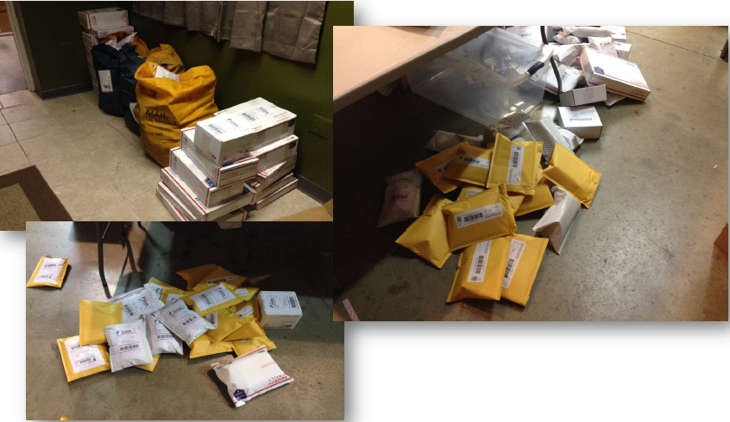
High Level Fence

Slide 27
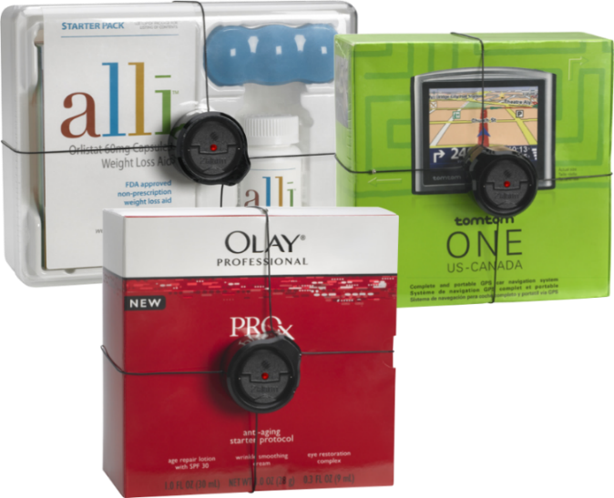
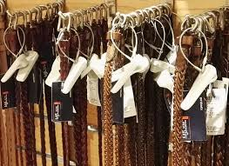
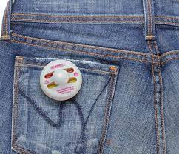
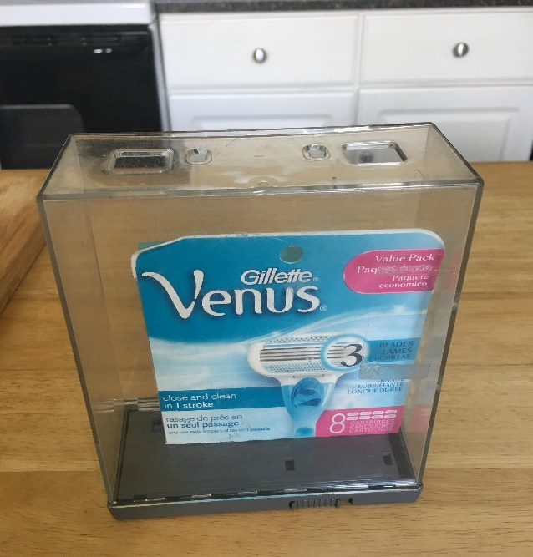
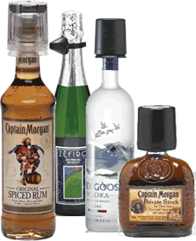
Product Protection Devices

Slide 28
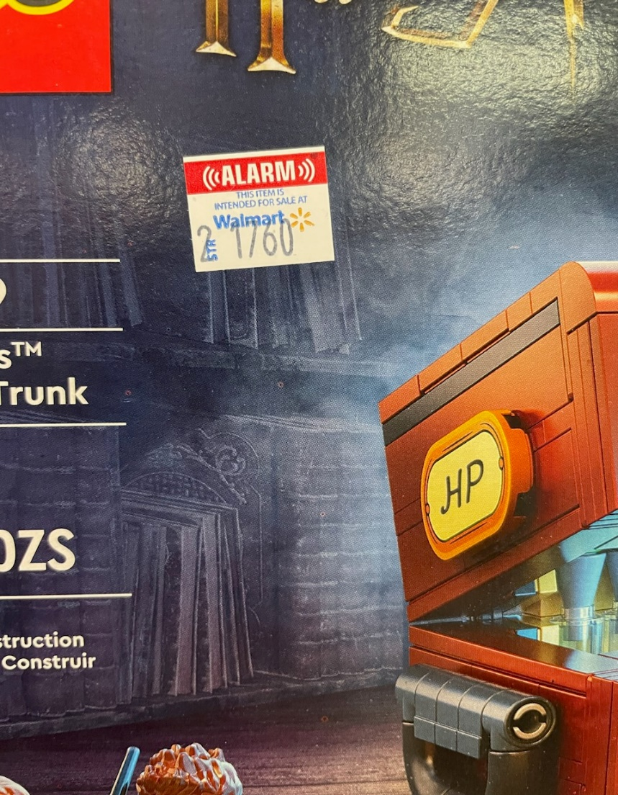
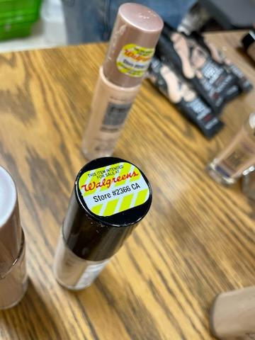
Store Specific Branding ID Labels

Slide 29
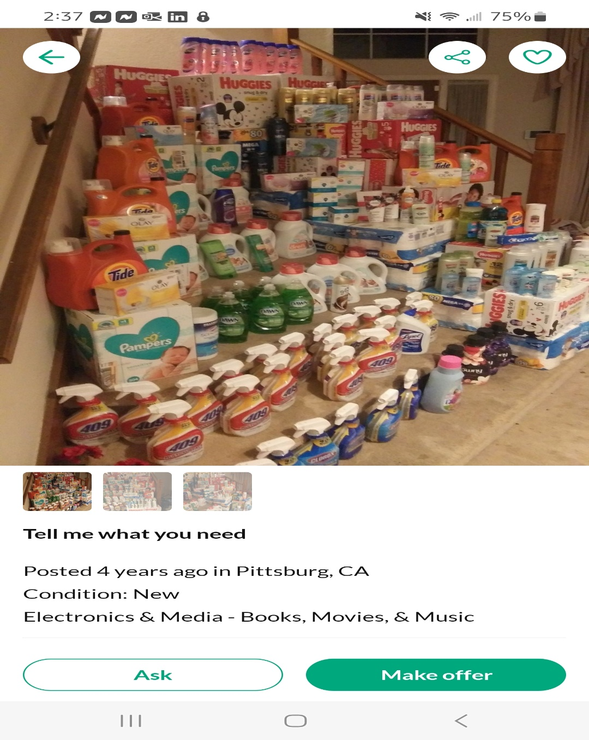
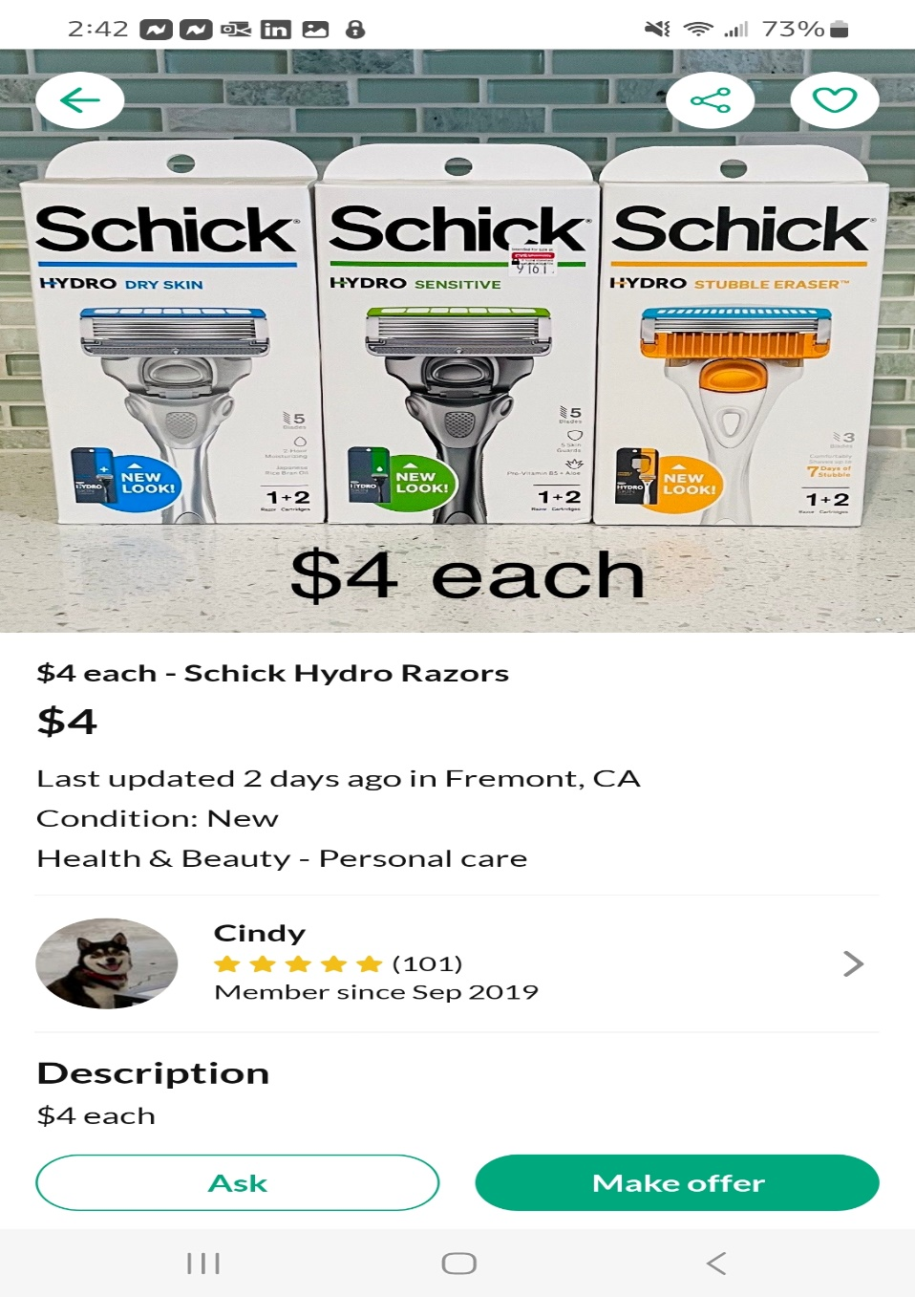
Social Media Platforms; Offer Up, Craigslist, Facebook

Slide 30
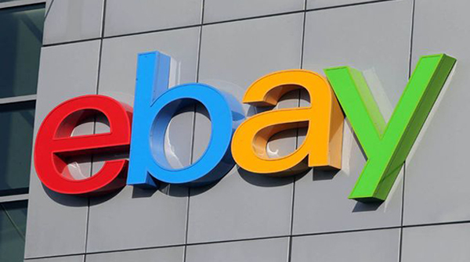
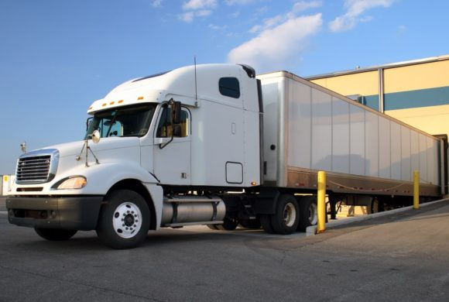
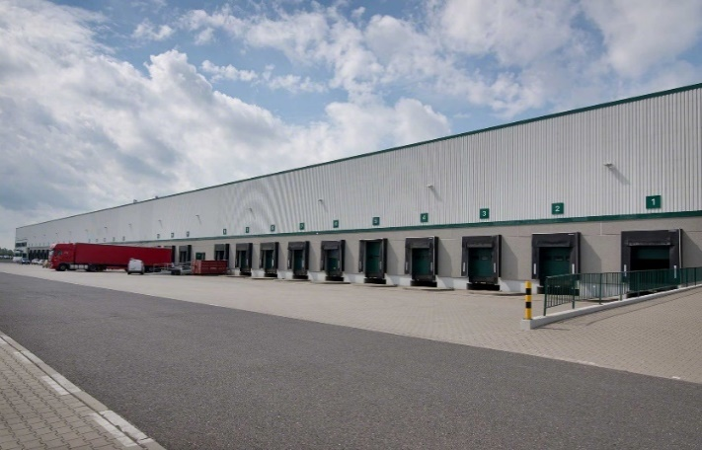
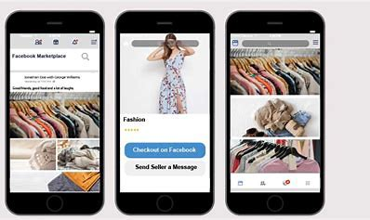
The Stolen OTC Product Is Moved Back Into The Commerce Supply Chain As Legitimate Product

Slide 31
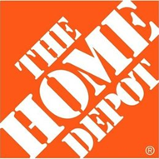
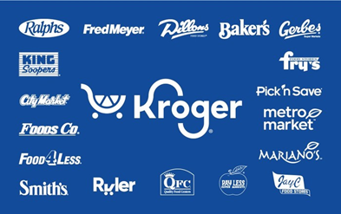
Retailers With ORC Investigations Teams

