Slide 1
Webinar Series – Part 4: Building a Successful Engagement Strategy: Using incentives and communication to drive participation
Rick Hecht, MFT, MBA
Director, HealthWorks Consulting and Customer Support Kaiser Permanente, Southern California
Peter Sepsis, MS, MPH
Senior Consultant, HealthWorks Consulting and Customer Support Kaiser Permanente, Southern California
Tamar Schnepp, MPH
Consultant Specialist - Union Health and Wellness Office of Labor Management Partnership
Kaiser Foundation Health Plan, Inc.
Notes:
Mike to do introductions

Slide 2
Agenda
Introductions and Past Webinar Review
Week Four Objectives
Reach and Impact
Incentives and Motivation
Highlight: City of Mountain View
Communication
Involving Unions in Wellness
Q & A
2

Slide 3
Previous Webinar Review
There is a healthcare crisis driven by lifestyle choices and fueled by obesity and sedentary behavior
Much of chronic disease is preventable with behavior change
The health of your employees directly affects your business and employers can make a difference
Rising health care costs are not sustainable
Getting people healthier is the only solution
A successful wellness programs needs strong leadership support
Using data is key to any successful wellness strategy
Data allows you to engage the right people, at the right time, with the right interventions
There are differences between activity-based and results-oriented wellness programs
A successful wellness program needs a blueprint that includes a multi-year strategy, goals and priorities, and a plan to reach those goals
There are different types of wellness initiatives, including value-based designs and policy and environmental changes

Slide 4
Objectives of Webinar Four
Understand the importance of reach and impact for a successful wellness program
Understand the difference between intrinsic and extrinsic motivation
Identify the most effective ways to communicate the wellness strategy to employees
Identify key communication strategies for communicating with labor

Slide 5
Four Steps to a Successful Workforce Health Program
STEP 1
Assess
STEP 4
STEP 2
Measure
Plan
STEP 3
Engage
5
Notes:
5
5
When you introduce a program, you’ll use an easy-to-understand, four-step model to address the key behaviors you can influence as an employer: prevention, stress, exercise, and nutrition. Let’s walk through the details of those steps.
Assess—you’ll learn where your company and your employees stand on workforce health.
Plan—set program goals and schedule your events and activities.
Engage—promote the program to your workforce.
Measure—evaluate your program’s successes and set priorities for future programs.

Slide 6
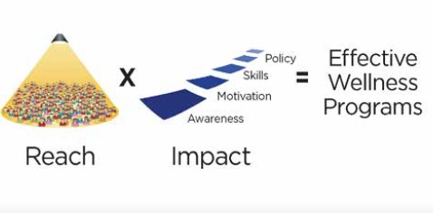
Plan to Maximize Reach and Impact

Slide 7
Reach
Maximize the number of people exposed to the program
Leadership support
Incentives
Communications
Impact
Meaningful interventions address the following four areas:
Awareness and Education
Skills and Tools
Motivation
Policy and Environment

Slide 8
What Drives Behavior Change?
Personal Behaviors
Skills & Tools
25%
Motivation 30%
Awareness & Education
5%
Policy & Environment
40%
8

Slide 9
Awareness and Education
Biometrics
Health Risk Assessment
Classes and Health Education
Awareness and Education
5%
Skills and Tools
Action plans
Goal setting
How to overcome barriers
Making healthy choices
Skills and Tools
25%

Slide 10
Motivation
Fear
Benefits
Pleasure
Peer Pressure
Incentives
Motivation 30%
Policy and Environment
Benefit Design
Workplace Policies
Policy and Environment 40%

Slide 11
Rewards and Incentives
Carrots and Frozen Carrots (Sticks)
Extrinsic Rewards
Financial rewards for participation, attaining a health status
Prizes, gift cards, cash, premium deductions, …
Evidence supports increased participation
Financial incentives do not generally led to sustained behavior change
Intrinsic (Internal motivators)
Be healthier
Live better
Age well
Sleep better
Achieve personal goals
Develop mastery
Seeing your kids grow up
Meeting your grandkids
11

Slide 12
Incentives and Motivation
Incentives may drive participation but not necessarily healthy behaviors
Incentives should align around healthy behaviors such as:
Physical activity
Healthy eating
Appropriate medical utilization
Tobacco free
Stress management
Extrinsic motivation can be used to jump-start a program, but not very effective at sustaining healthy behavior
Intrinsic motivation taps into internal desires to develop mastery, get better at something, enjoyment
Without internal motivation the positive behavior will stop

Slide 13
Rewards and Incentives
Trinkets and T-shirts (10-15%)
Merchandise (20-40%)
Cash & Gift Cards (40-60%)
Link Wellness Program to the benefit plan (90%+)
13

Slide 14
Communication
Communication is key to a successful wellness strategy
Use clear communication to engage, energize and empower
Don’t force it on people- a negative approach- forcing people to participate will backfire
Tell people why you are doing it
Caring is the main ingredient
Caring is a force without force (no bullying)
Over communicate times 10
Print- flyers, posters, home mailings
Verbal- meetings, voicemails, events
Technology- emails, websites, webinars, texts
People don’t remember what you did for them, they remember how you make them feel
14

Slide 15
Communication Tips from WELCOA
The way you deliver the message is key:
The magic ingredient is: “We care about you and your health”
Here’s our vision for wellness
This is when it kicks off
Here’s how you can be a part of it
We’re already in
We’re here if you have any questions
Together we are better
15

Slide 16
Communication
Change Your Words, Change Your World
Andrea Gardner
16

Slide 17
What Doesn’t Work?
Activity-based programs vs Results-oriented programs
No long-term strategy
Lack of leadership support
No commitment to resources
Rewards to nowhere
One size fits all programs
Low engagement
Poor communication
No Goal in mind
Trying to do too many things at once

Slide 18
What Works?
Results-oriented, customized, comprehensive programs
Linked to your mission and business strategy
Based on Assessments and Data analysis
Has Senior Leadership support and endorsement
Multi-year strategy focused on creating a culture of health
Strong Communication and Promotion
Wellness Committees and Champions
Something for everyone
The right incentives and rewards
Defined goals around what success looks like
Measuring and evaluating

Slide 19
Key Strategies for Communicating With Labor
The Case for Union Participation in Wellness – Examples
How Unions Can Make the Difference in Wellness
Understanding Union Leadership and Wellness
Understanding the Union Core Mission and the Union View on Wellness
How to Approach Union Leaders and Union Audiences

Slide 20
The Case for Union Participation in Wellness Examples
Santa Clara Schools – Total Health Assessment (HRA) participation
473
Joint labor actions
35
“A Case Study in Wellness & Cost Management in the Public Sector”
(Highlighted at IFEBP conference, 2012)
A joint pilot with CalPers, CA HR, and SEIU Local1000

Slide 21
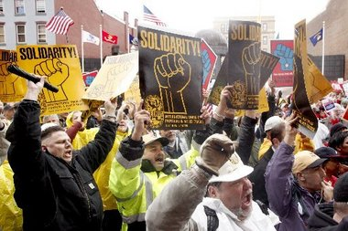
How Unions Can Make the Difference in Wellness
What unions can bring:
Trusted negotiators & communicators
Insight into employee perceptions
Sustainable structures – participatory decision making, communications, leadership development, employee involvement
Moving forward without unions:
Higher risk of backlash
Higher risk of resistance and rejection
Lower levels of participation in activities
Less diversity

Slide 22
Understanding Wellness and the Union Leadership
1/24/12 This is the Federation Hotline for Jan. 24. WFSE/AFSCME PLEDGES TO WORK WITH SENATORS ON BILL PROMOTING STATE EMPLOYEE WELLESS AND PRODUCTIVITY A bill with good intentions to promote the ability of state employees to get preventative help with medical issues had a hearing Monday (Jan. 23) before the Senate Health and Long-Term Care Committee. SB 6429 would direct the state Health Care Authority to build a broad strategy to support state employee health and wellness. It would include undefined financial incentives. It comes in the wake of a program in King County. However, Federation Executive Director Greg Devereux cautioned that that model may not fit statewide. “We pledge to help” refine the bill, Devereux said.
Union Leadership – Their Priorities and Interests
Who are the leaders?
Elected union leaders and staff
Rank and file leaders
What defines their interests?
Responsive to the membership issues (core mission), membership complaints, membership current interests – Need to demonstrate their value
How do they lead?
Union leaders lead through participatory process, education, trust, influence, and persuasion.

Slide 23
Understanding Wellness and the Union Core Mission
Union Risks
Union Opportunities
Wages & Benefits
Higher contribution for health benefits associated with wellness (Carrot vs. Stick)
Rights at Work
Employee/ union member perceptions that programs and incentives are shaming or punitive.
Union Member Satisfaction
Angry members that demand action from the union
Social Justice
Do wellness initiatives add stress to working people?
Other Priorities
Other issues are more pressing
Wages & Benefits
Initiatives that decrease healthcare costs and Increase money available for wages and benefits
Rights at Work
Opportunities for increased member satisfaction at work
Union Member Satisfaction
Wellness can bring a new level of member leadership
Social Justice
Working families suffer the most from chronic health problems - Can the union be part of the solution?
Other Priorities
Wellness initiatives support pressing priorities

Slide 24
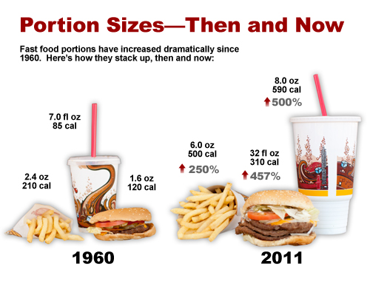
Approaching Union Leaders & Members
Approaching Union Leaders
Assume caring – “We know that you are as aware and concerned as we are about the health problems your members are experiencing. “
Talk about opportunities & acknowledge the risks – “There are many opportunities for employees through wellness initiatives, but we also understand that there are risks in how the program is designed, administered, and communicated.”
Promote union participation – “We want to hear more about the risks and opportunities from your end. We are learning that union participation is key to developing a successful wellnes program.”
Present a vision of partnership –”We would like to explore how we can work together to develop a mutual vision and agree on key program elements”
Talking to Union Audiences
Assume caring
Avoid blaming or shaming
Acknowledge their value and their real barriers
Emphasize the need for partnership and support
Invite employees to support each other

Slide 25
Thank you!

Slide 26
Questions
Visit http://www.cacities.org/citiesforworkforcehealth
Flyer, FAQ, and contact info available on the website
Visit http://www.healcitiescampaign.org and link to “contact us”
Video link: www.youtube.com/watch?v=Hzgzim5m7oU
Notes:
Mike

